Slide 1
Introduction
Video clip of Yvonne Moir, talking about 2020….the challenges etc etc
Course closed pic?
Zoom call pic?
Course Re-opened end May, competition play from end June
Lucky to get most competitions played…
No Prizegivings….time to acknowledge achievements

Slide 2
Ryan Ingram won the Sandy Thain Junior 3 Club Trophy

Slide 3
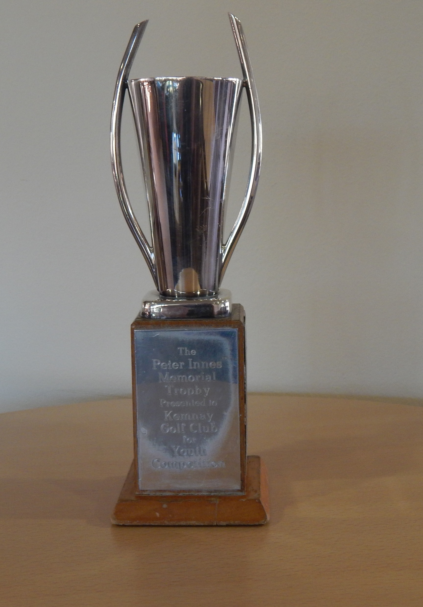
Thomas Simons won the Innes Cup Junior Matchplay trophy

Slide 4
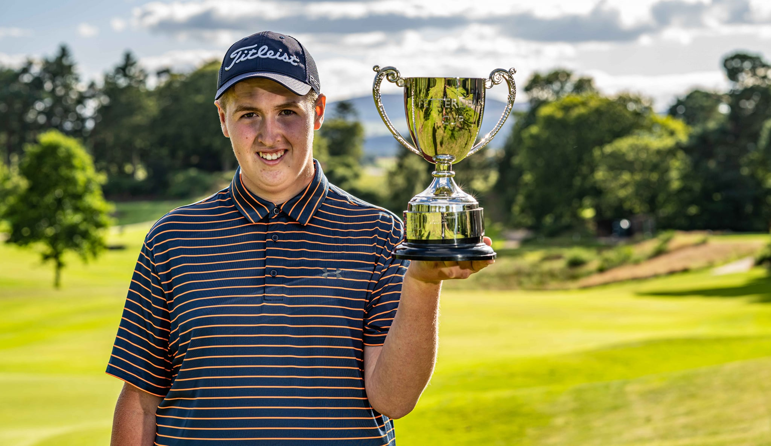
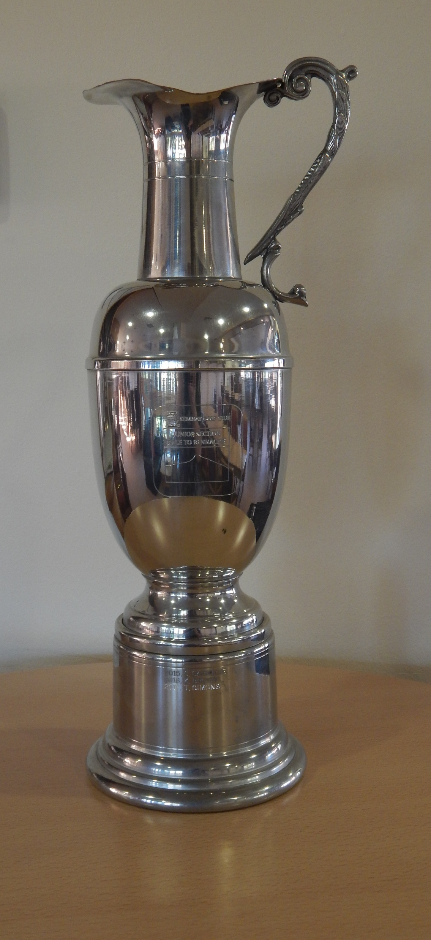
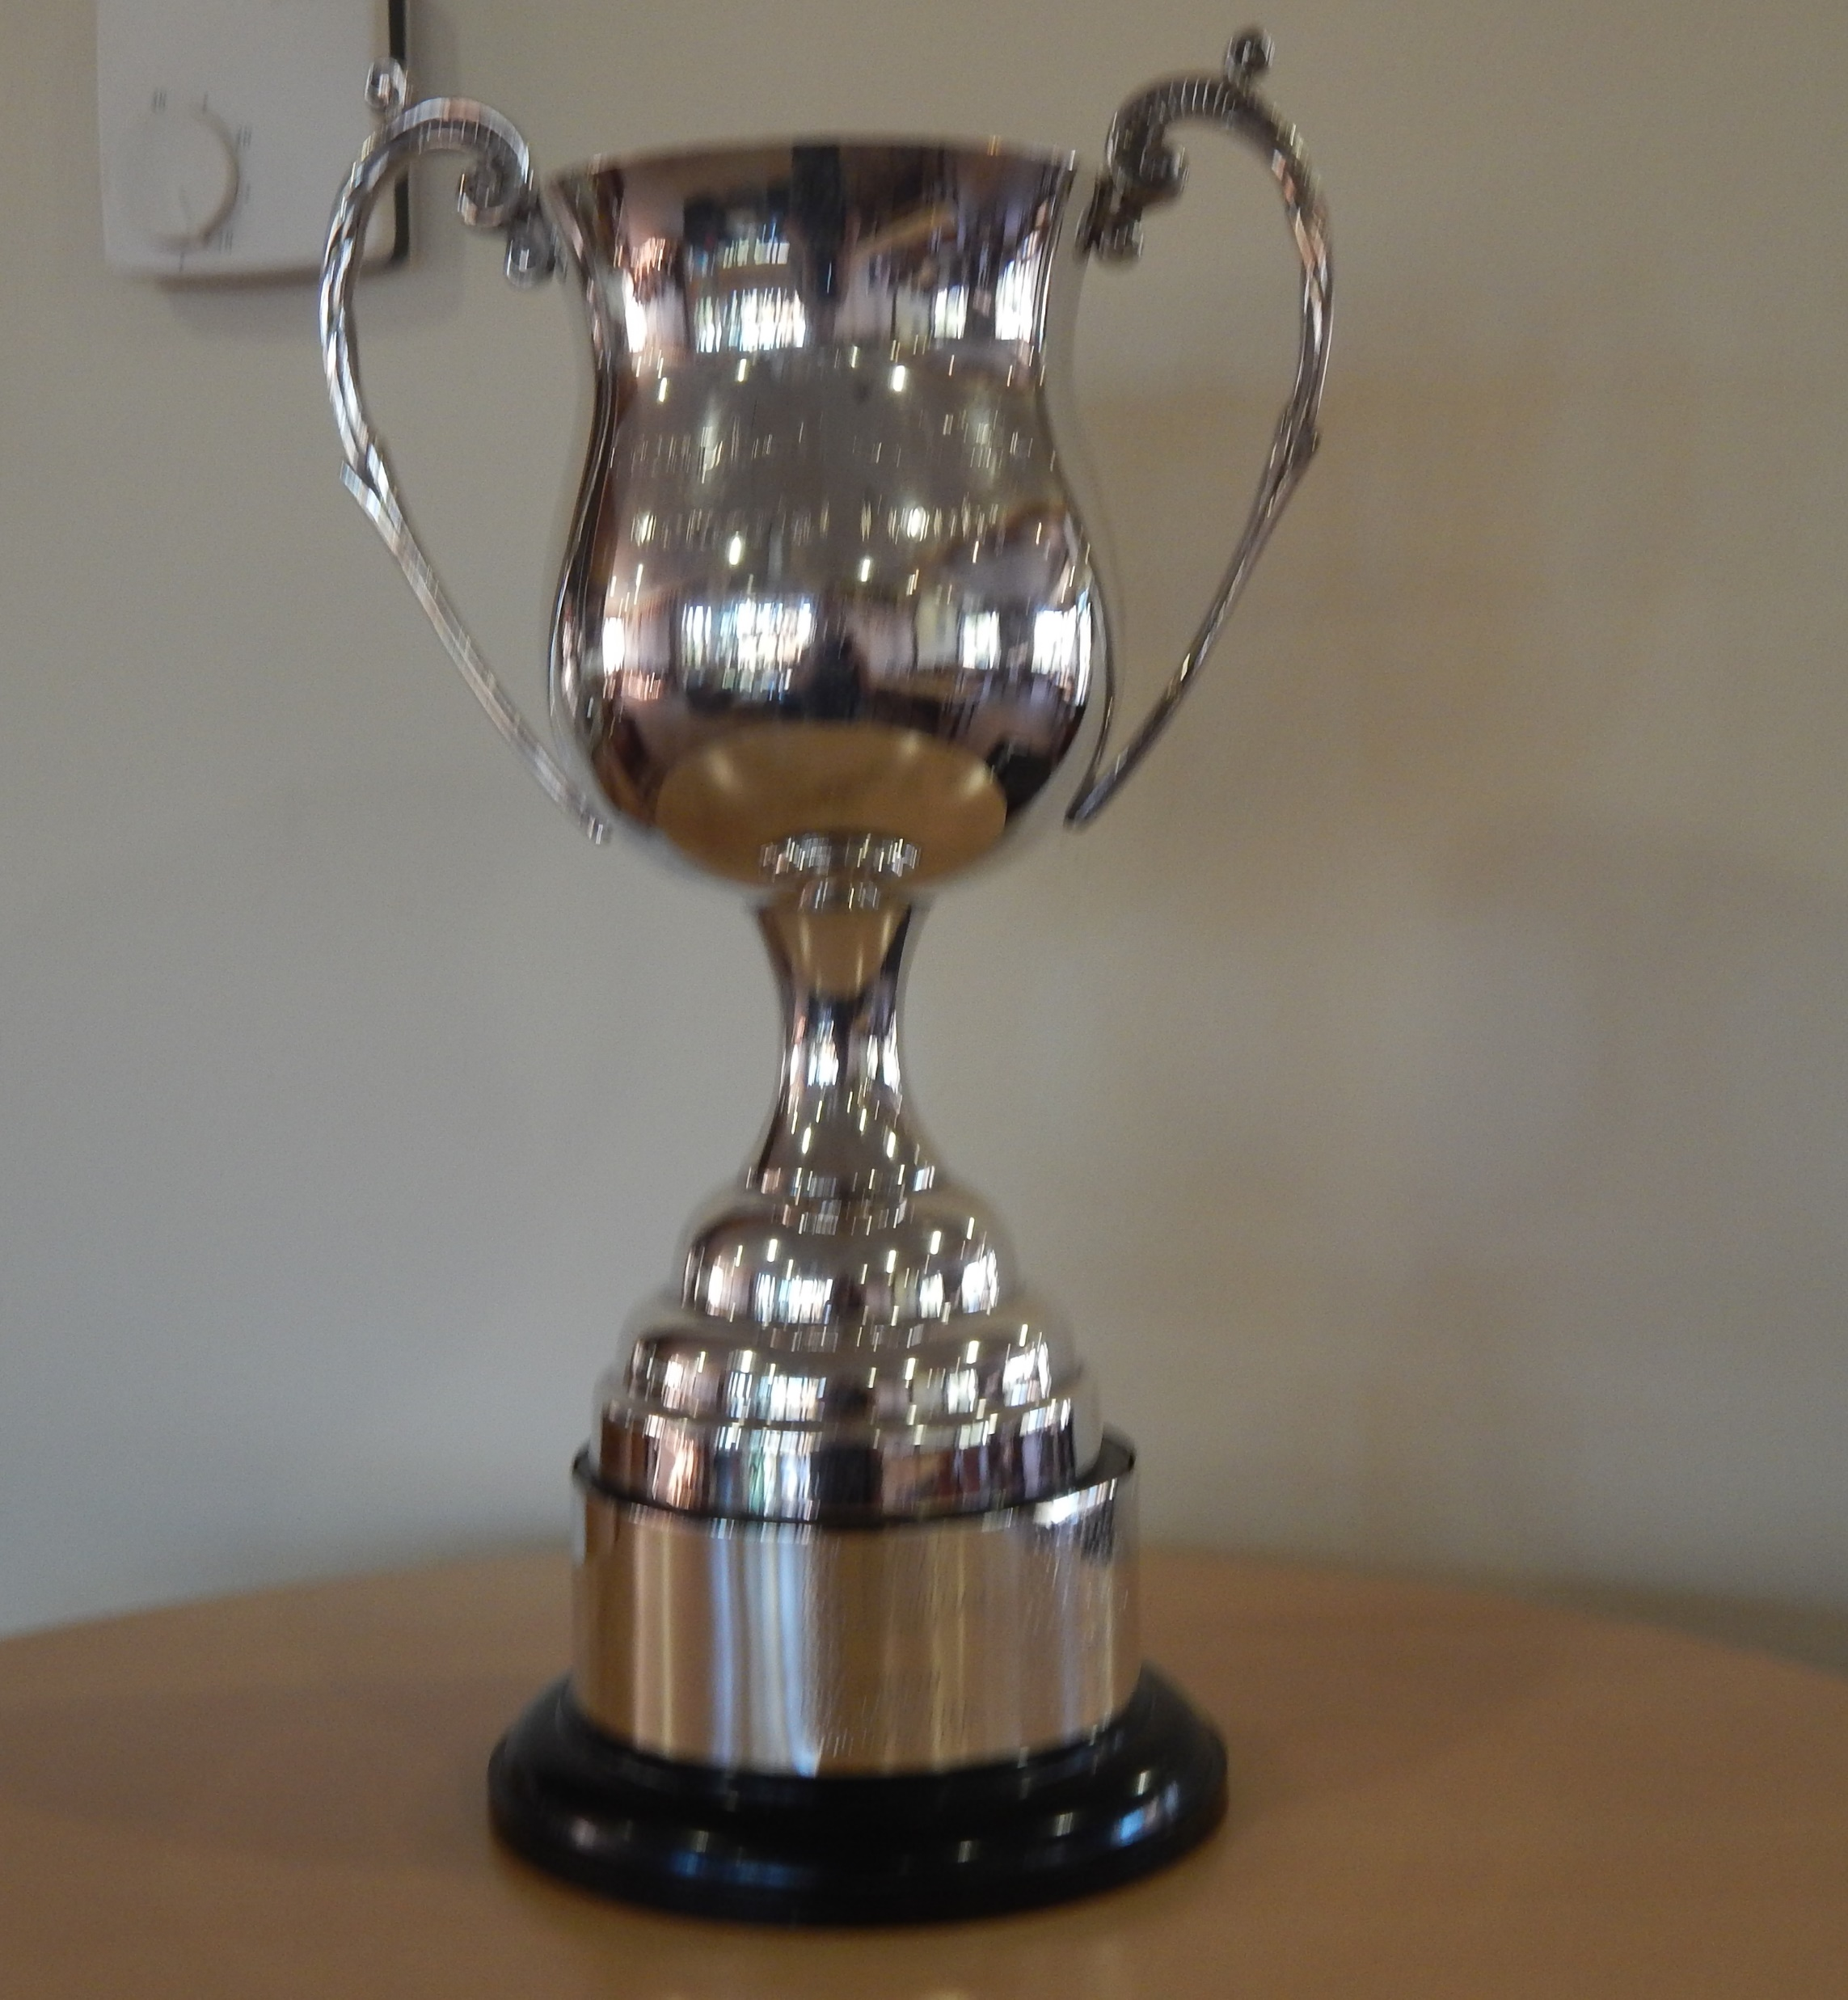
Fraser Laird won the Junior Order of Merit – the ‘Race to Bennachie’ (add in) and the Junior Campbell Pirie Trophy (add in)

Slide 5
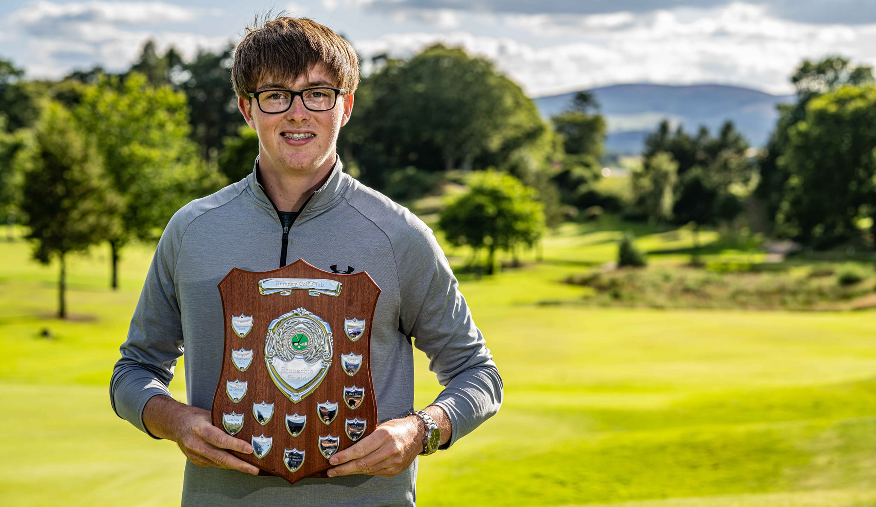
Fergus Morgan won the Junior Handicap Championship – the Bennachie Shield

Slide 6
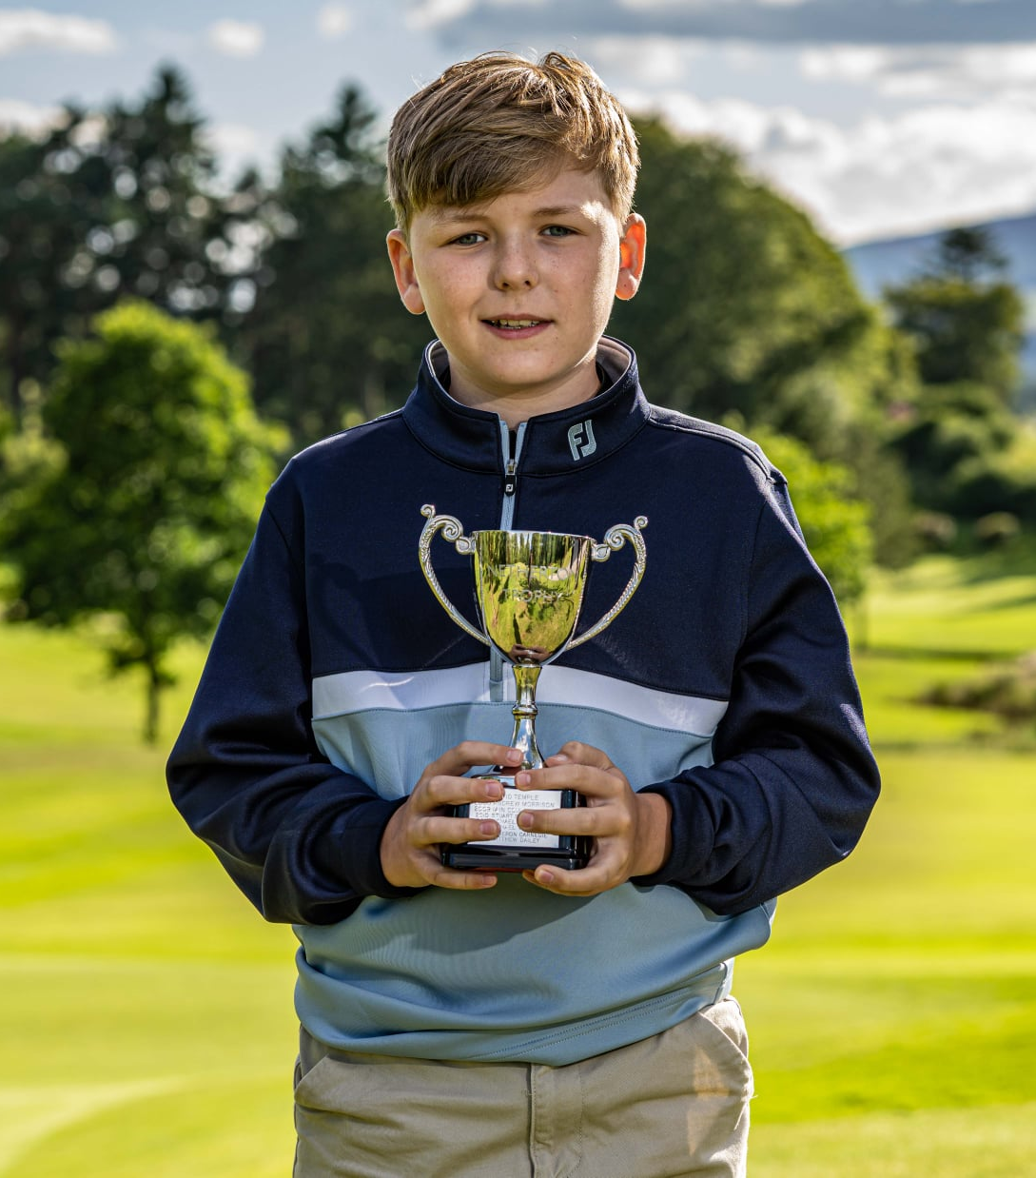
Zack Don won the Junior Boys Championship – the Netherton Trophy

Slide 7
Fraser Laird won the Youth Championship – the Fetternear Trophy - for the 3rd time in a row!

Slide 8
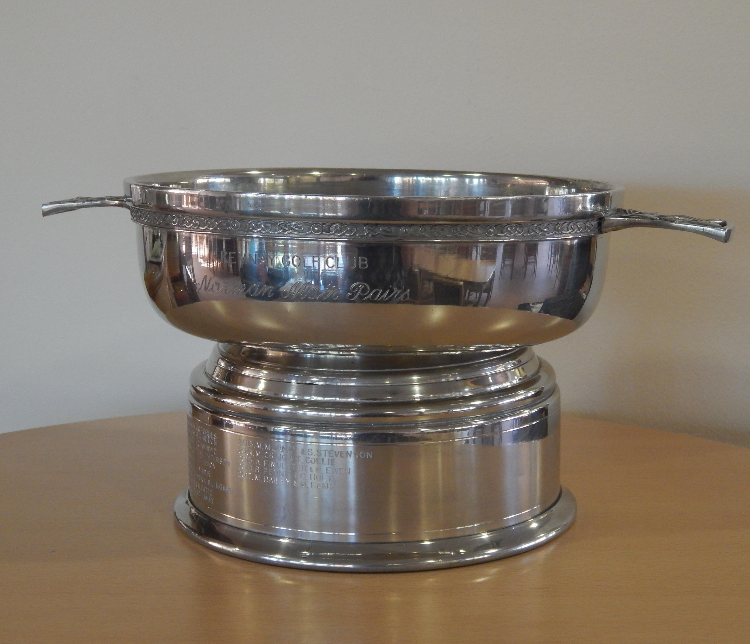
Phil Murray & Salter Watson won the Norman Moir Pairs Trophy

Slide 9
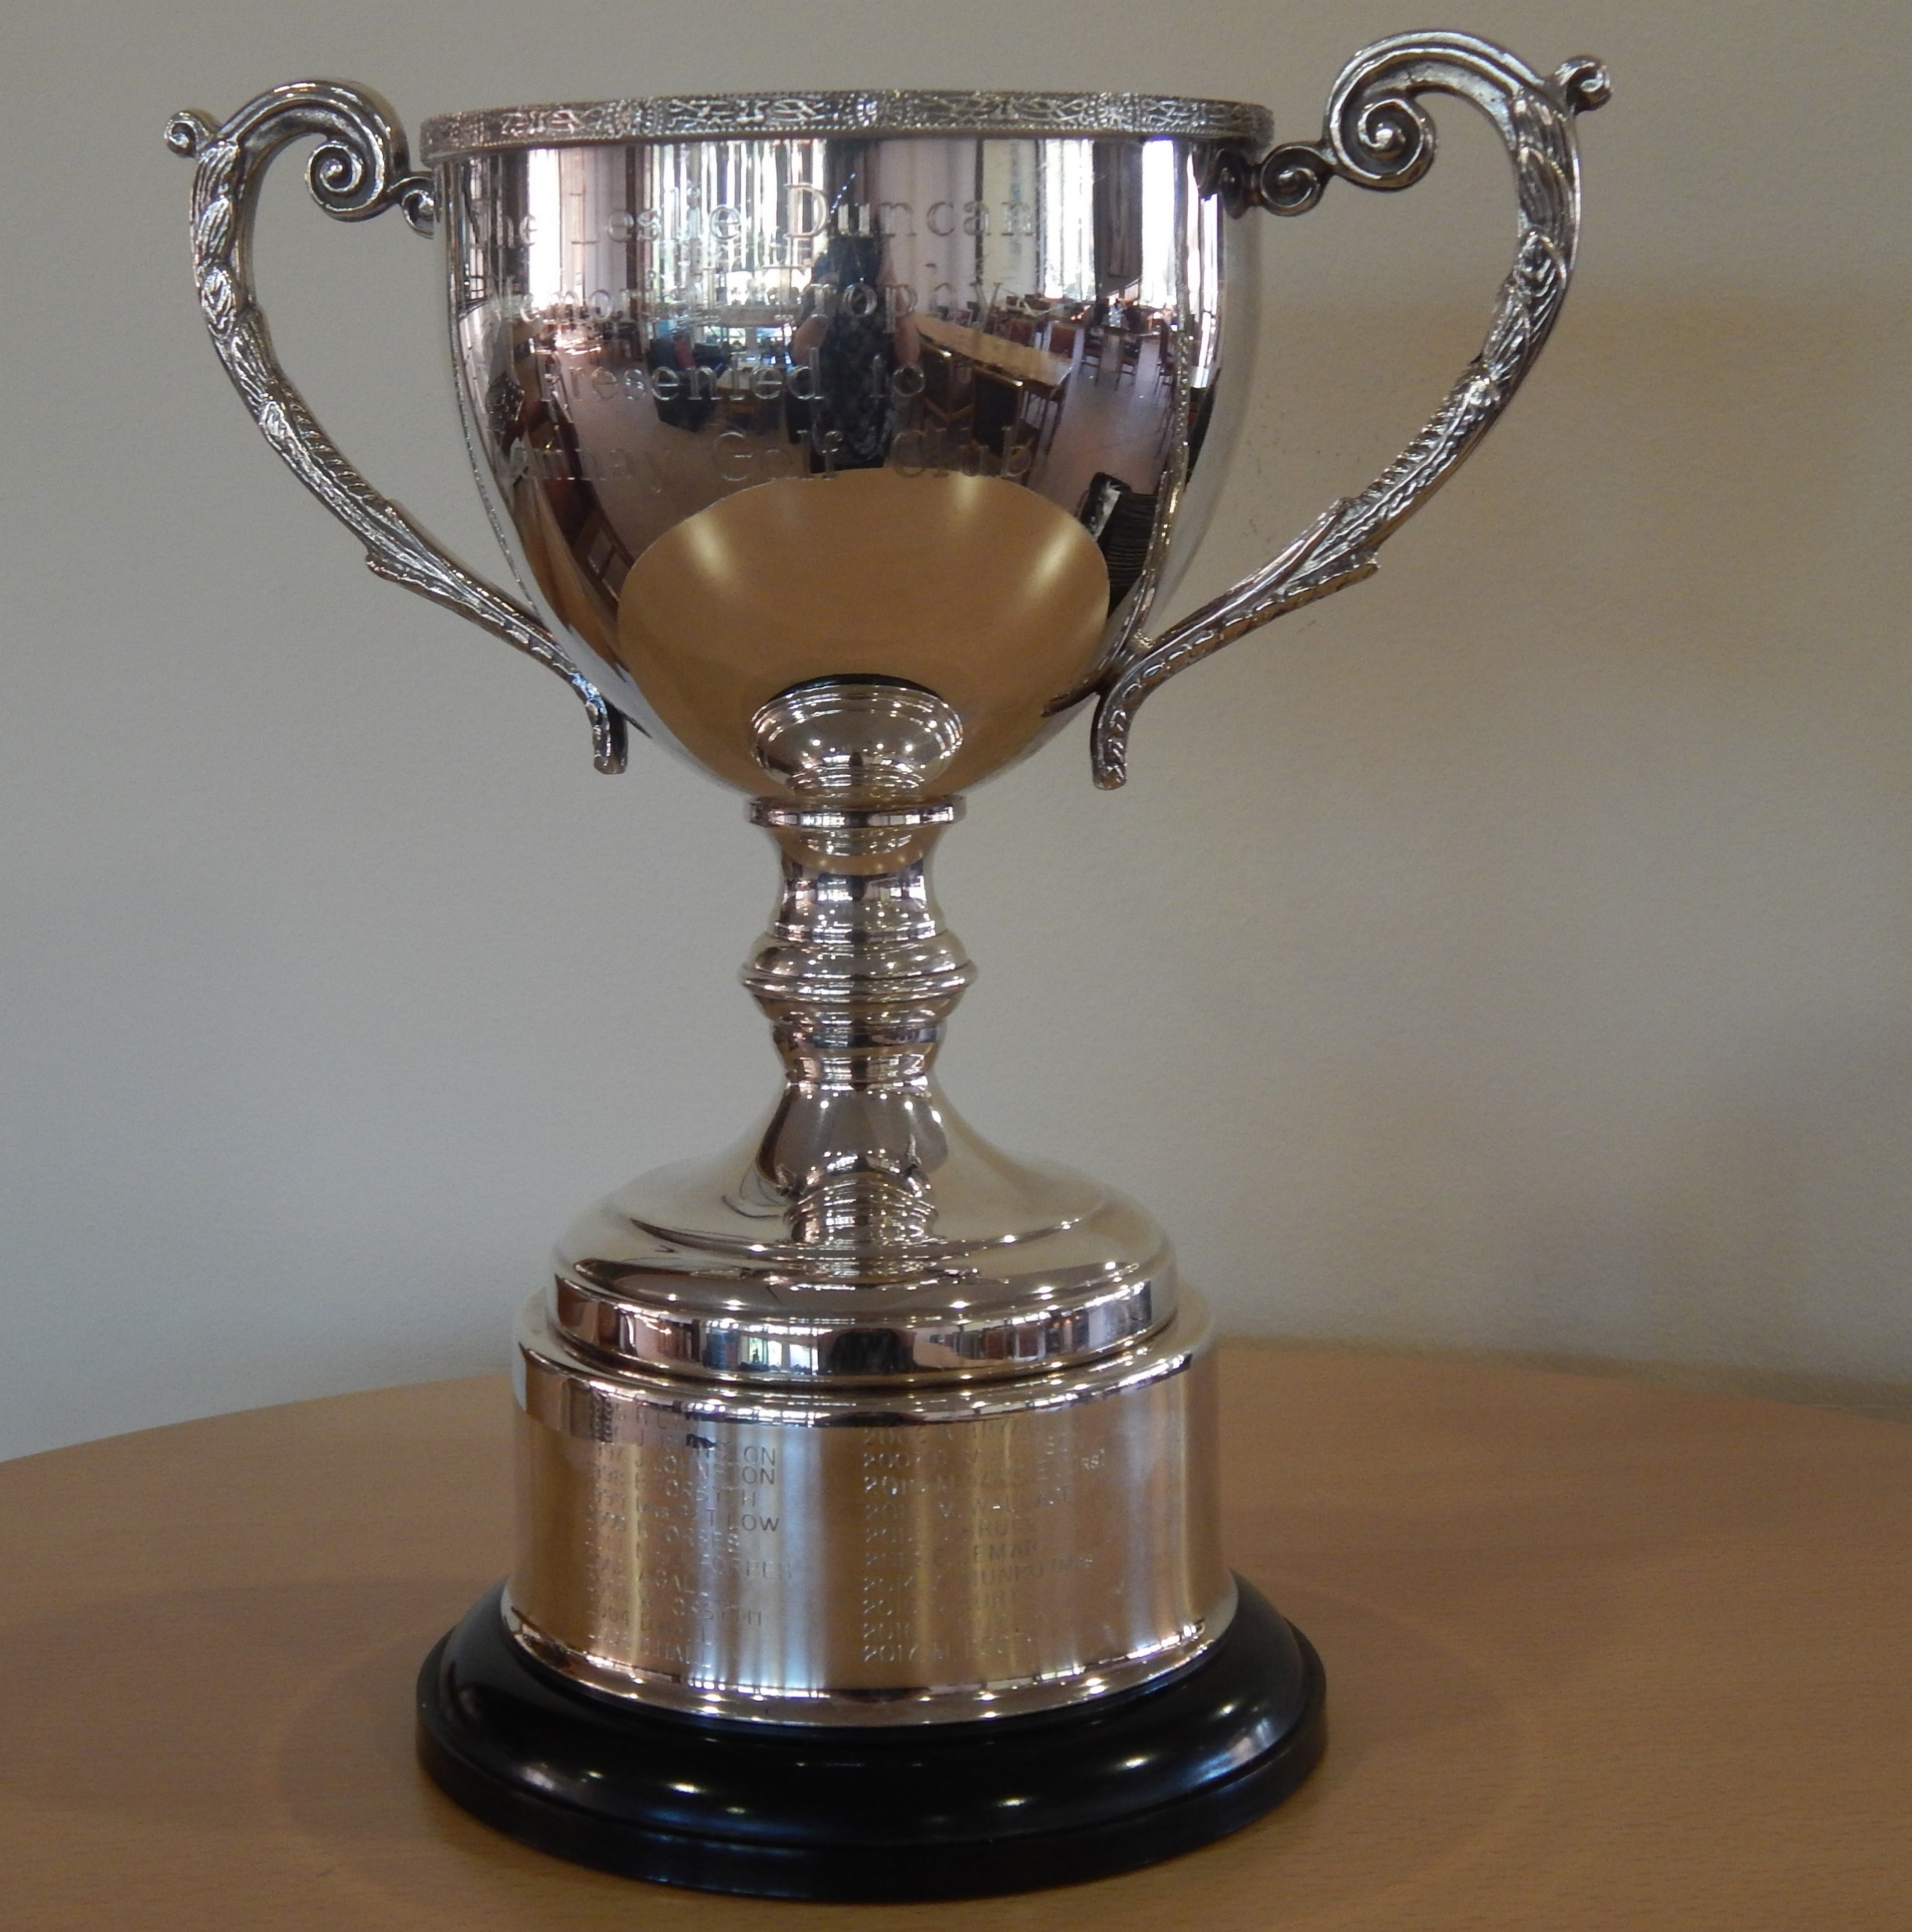
Philip Scott won the Leslie Duncan Memorial Trophy

Slide 10
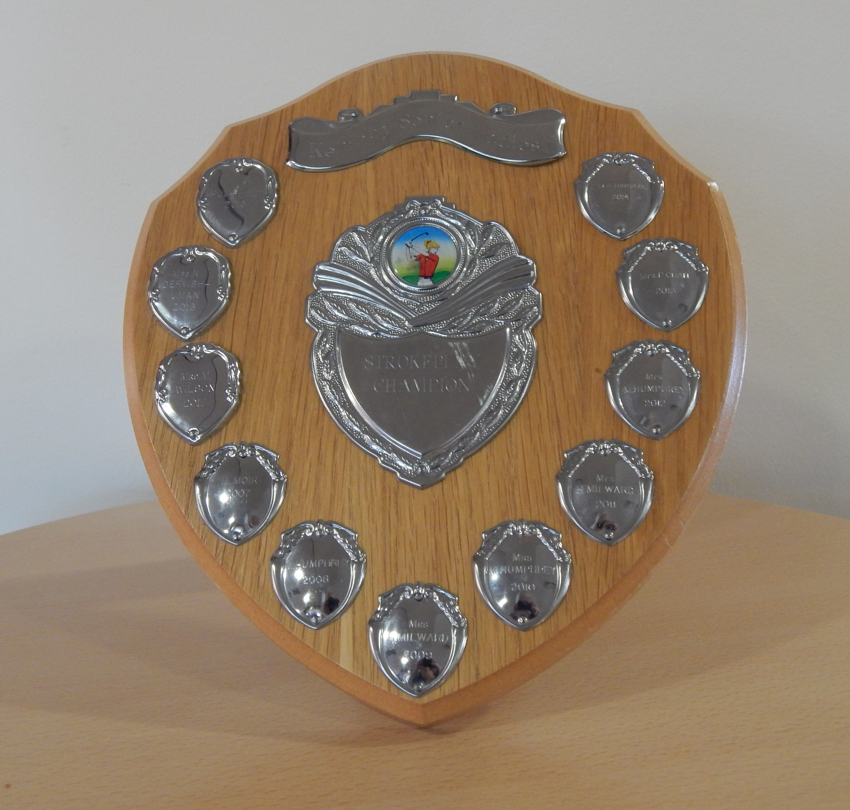
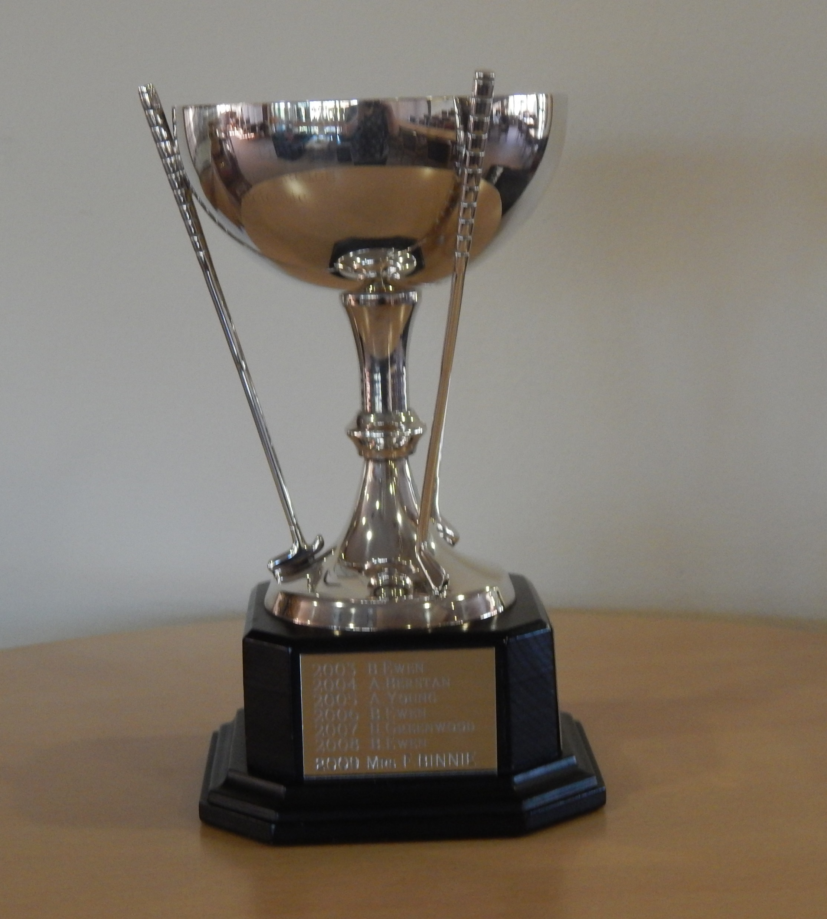
Eleanor Chadbourn won the Senior Ladies Shield and the Moir Cup (Eclectic) Trophy

Slide 11
Eddie Rothnie and Colin Kerr were joint winners of the Senior Gents Winter Quaich

Slide 12
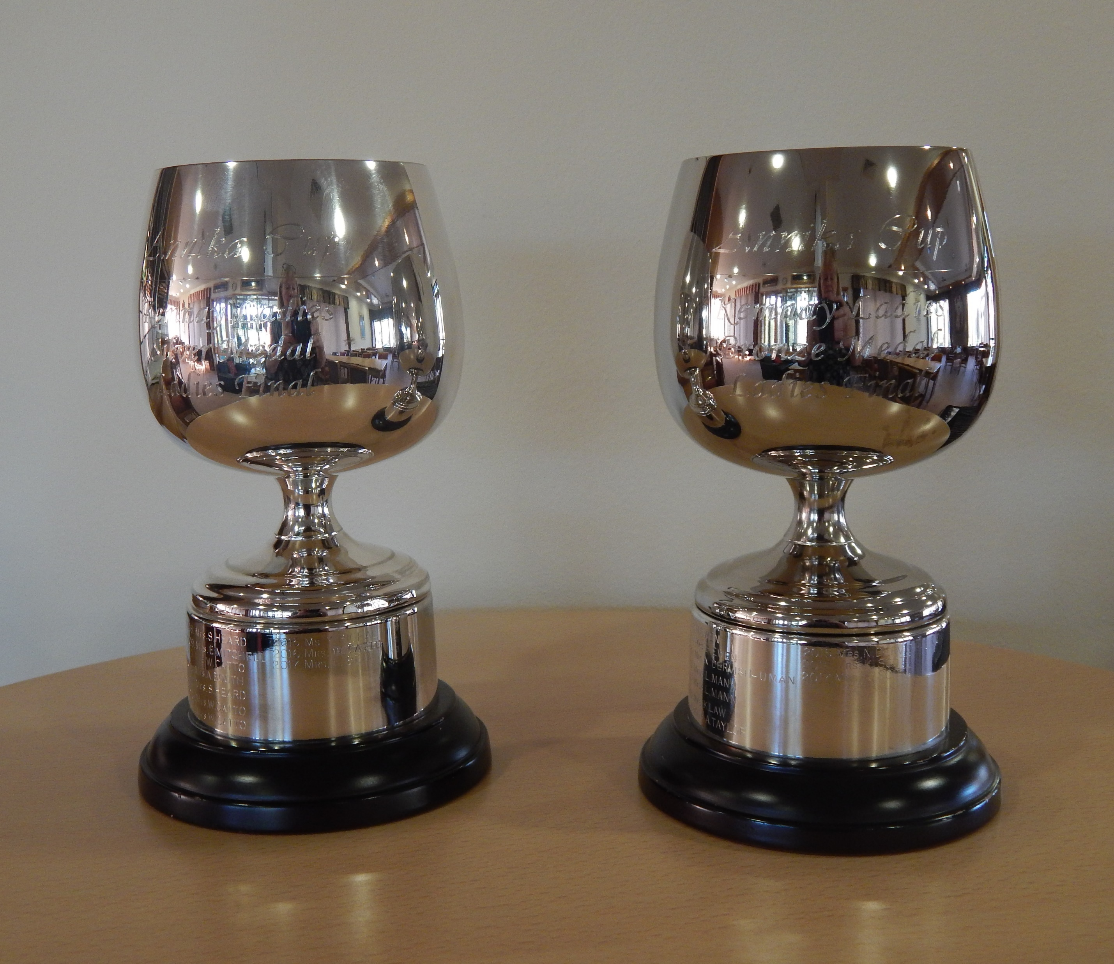
The Ladies Medal Winners Playoff was won by Wilma Catto (silver) and Anne Munro (bronze)

Slide 13
Jim Murison won the Senior Gents Claret Jug (White Tee Medal playoff)

Slide 14
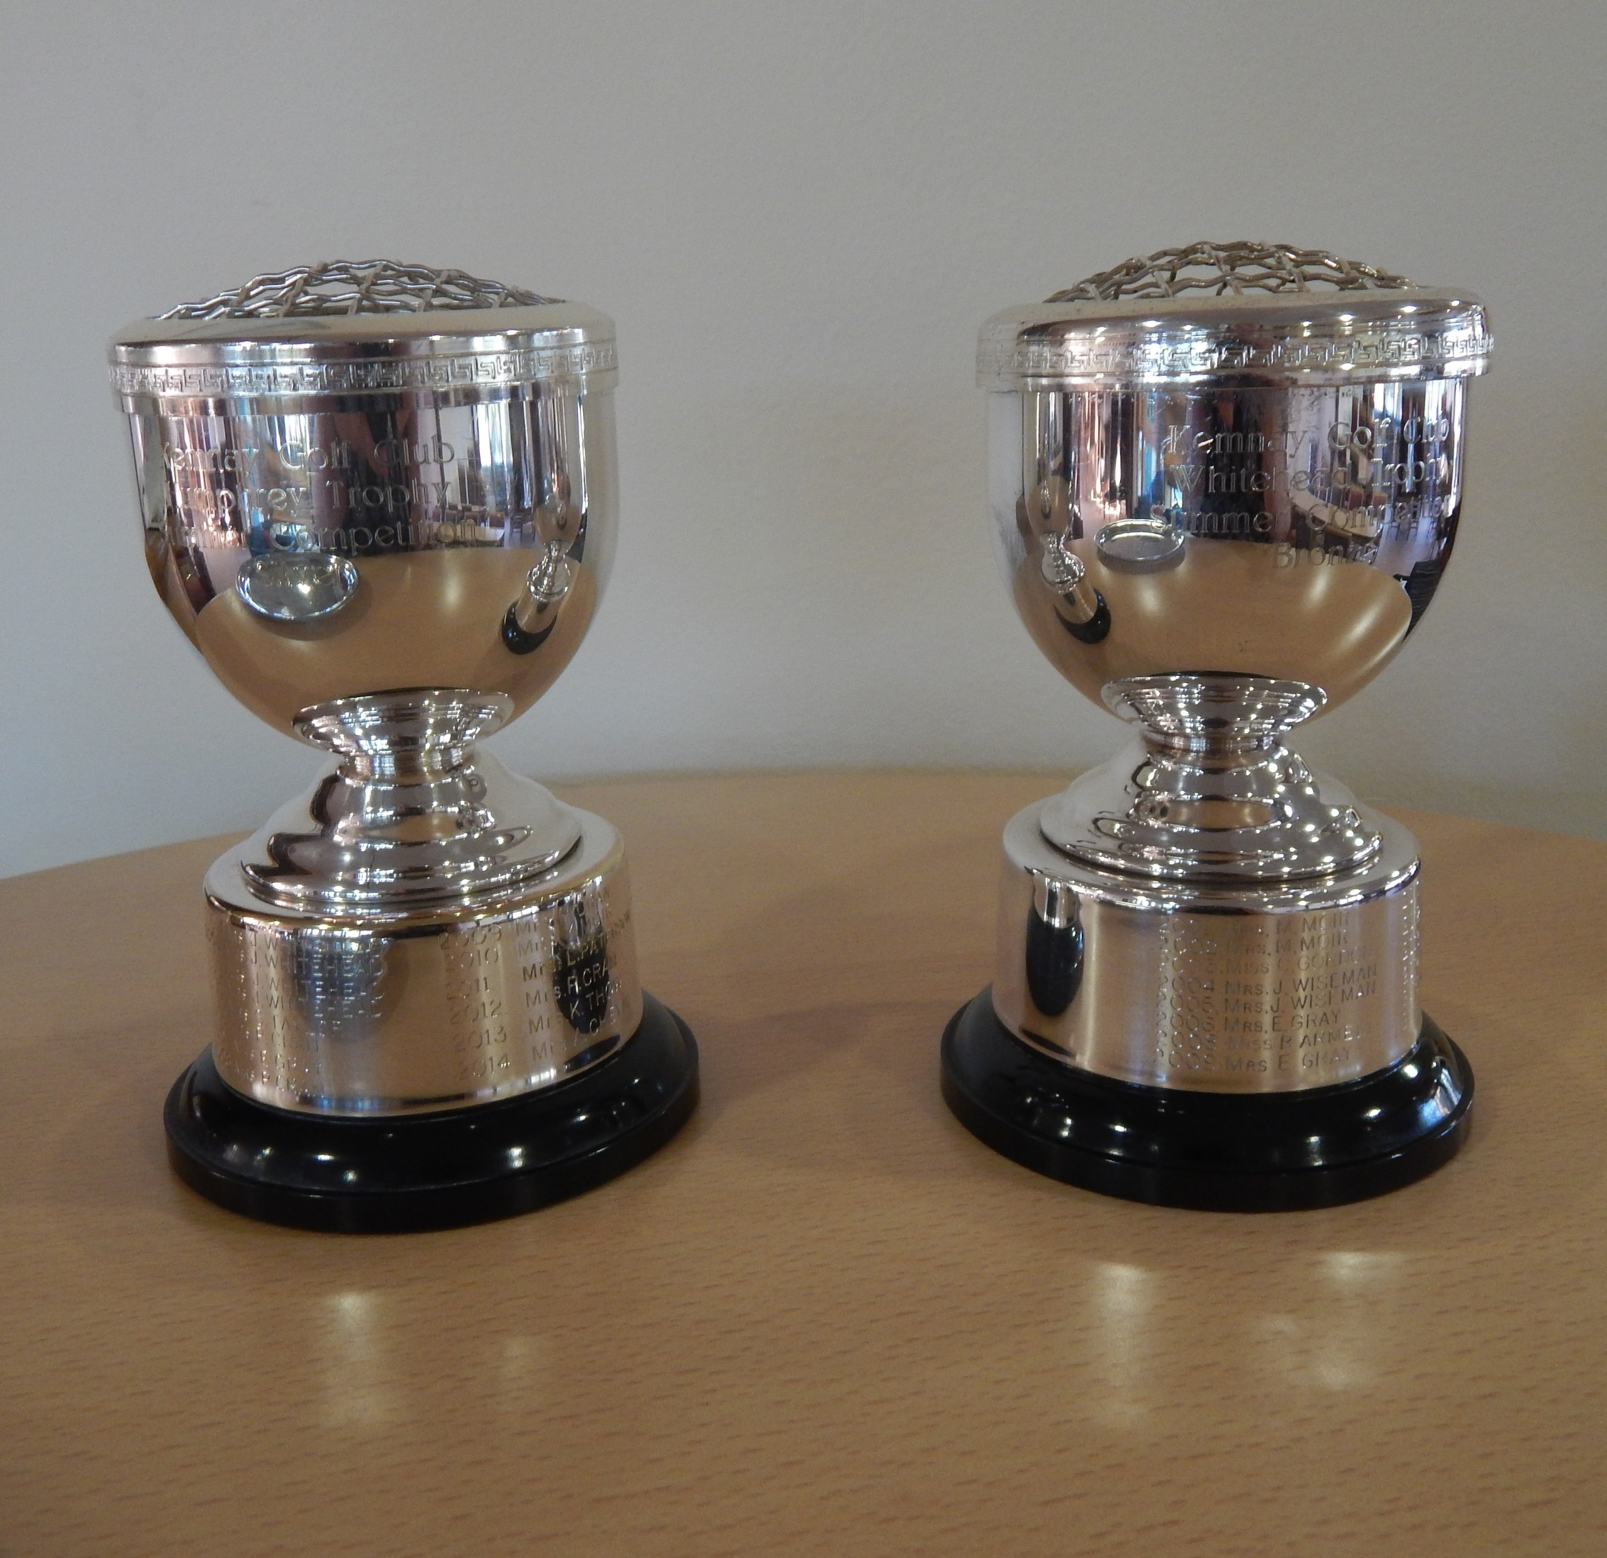
The Ladies Summer Trophies were won by Fiona Pennie (silver) and Karen Scott (bronze)

Slide 15
The Senior Gents Kirkstyle Plate(Yellow Tee Medal playoff) was won by Andy Devlin. Andy also won the Mike Kenny 3 Club Trophy.

Slide 16
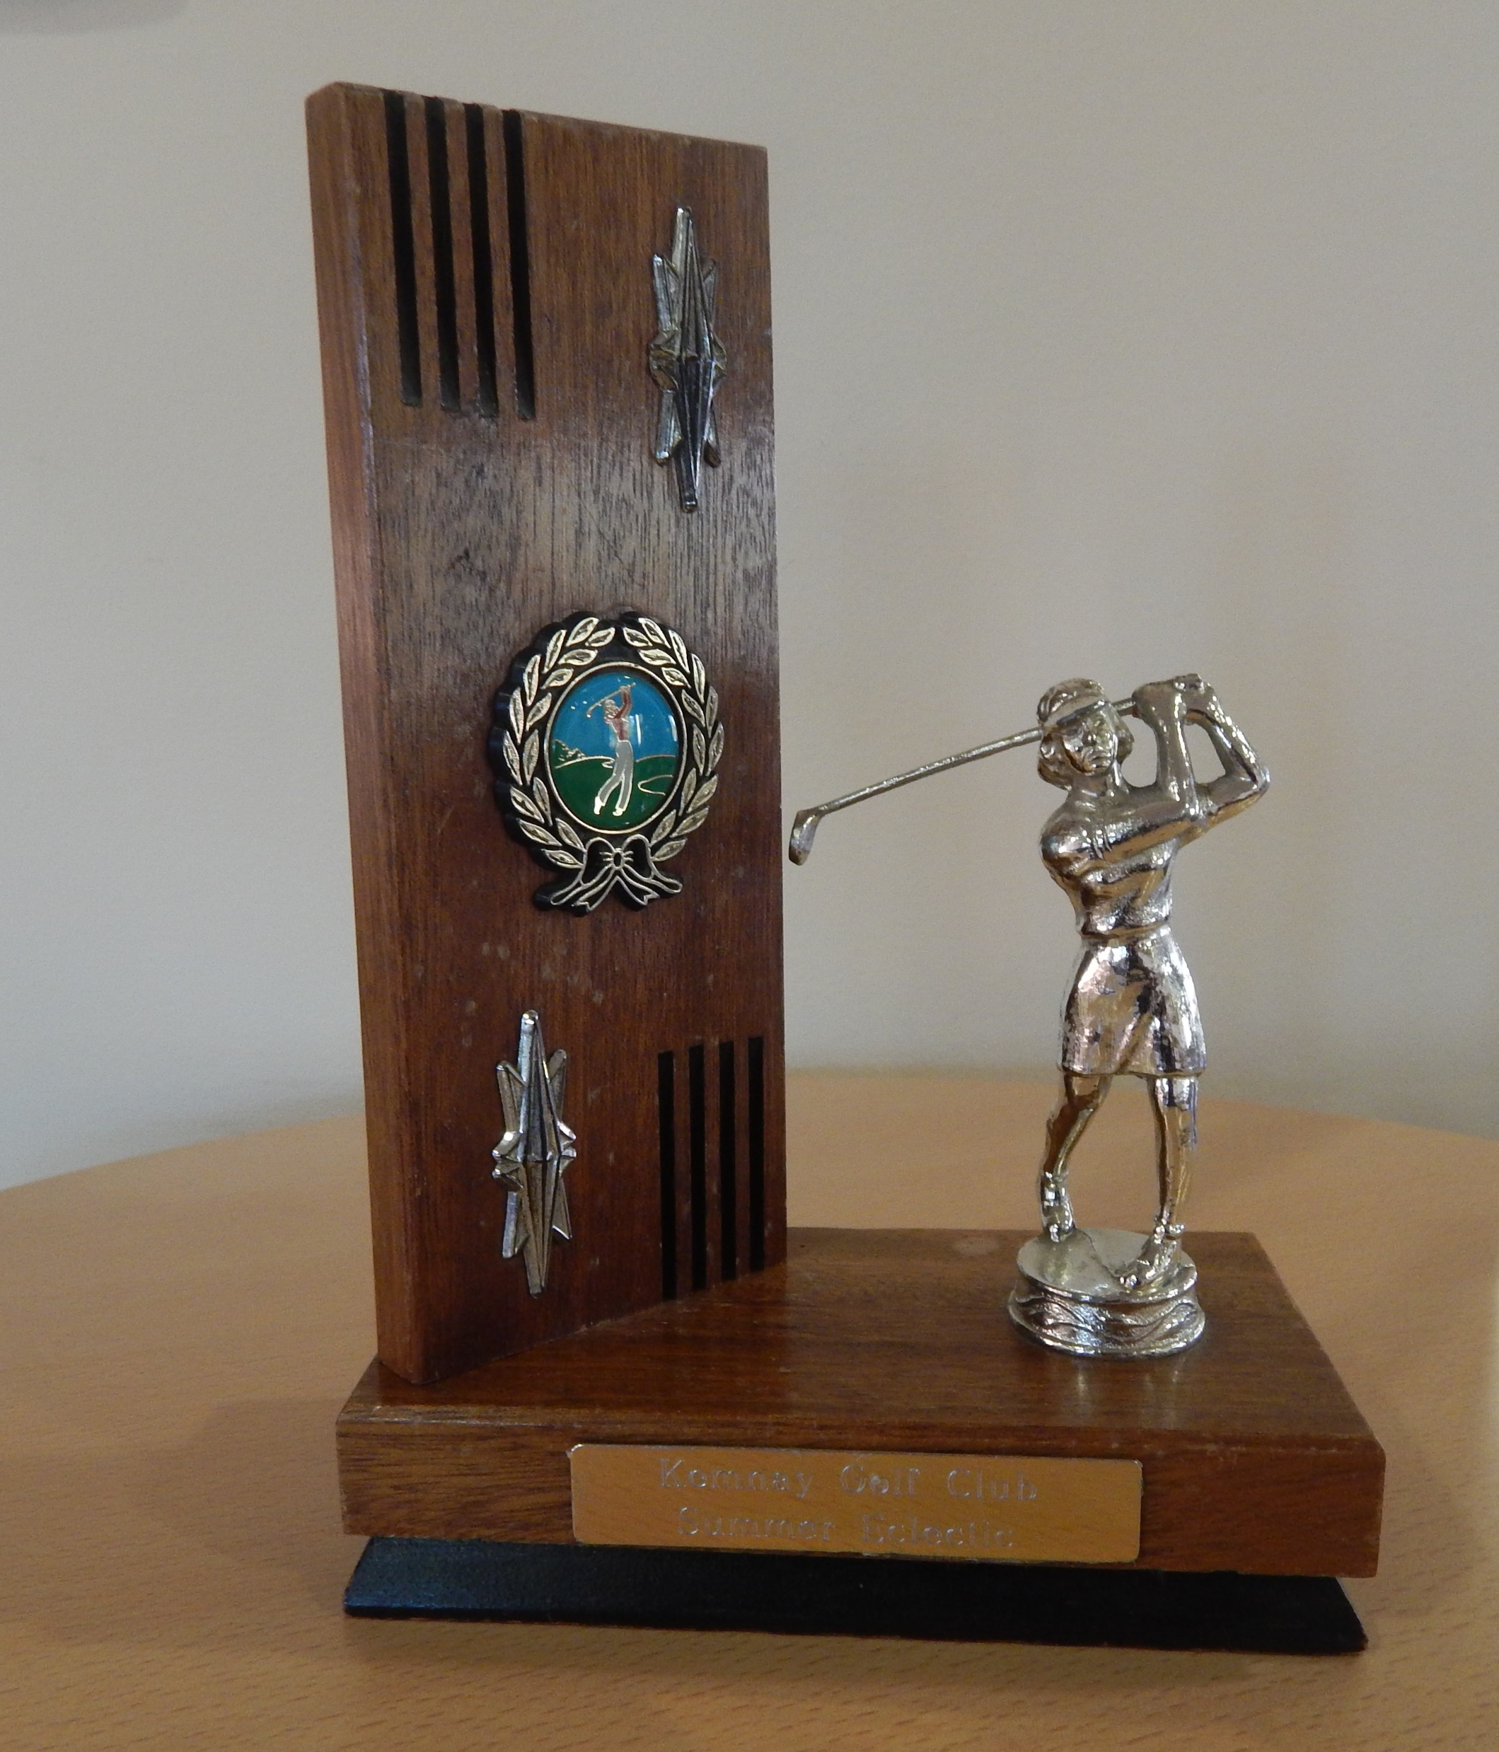
The Ladies Summer Eclectic was Trophy was won by Linda Bell

Slide 17
Joint winners of the Senior Gents Summer Quaich were Keith Boyde and Brian Lawrie

Slide 18
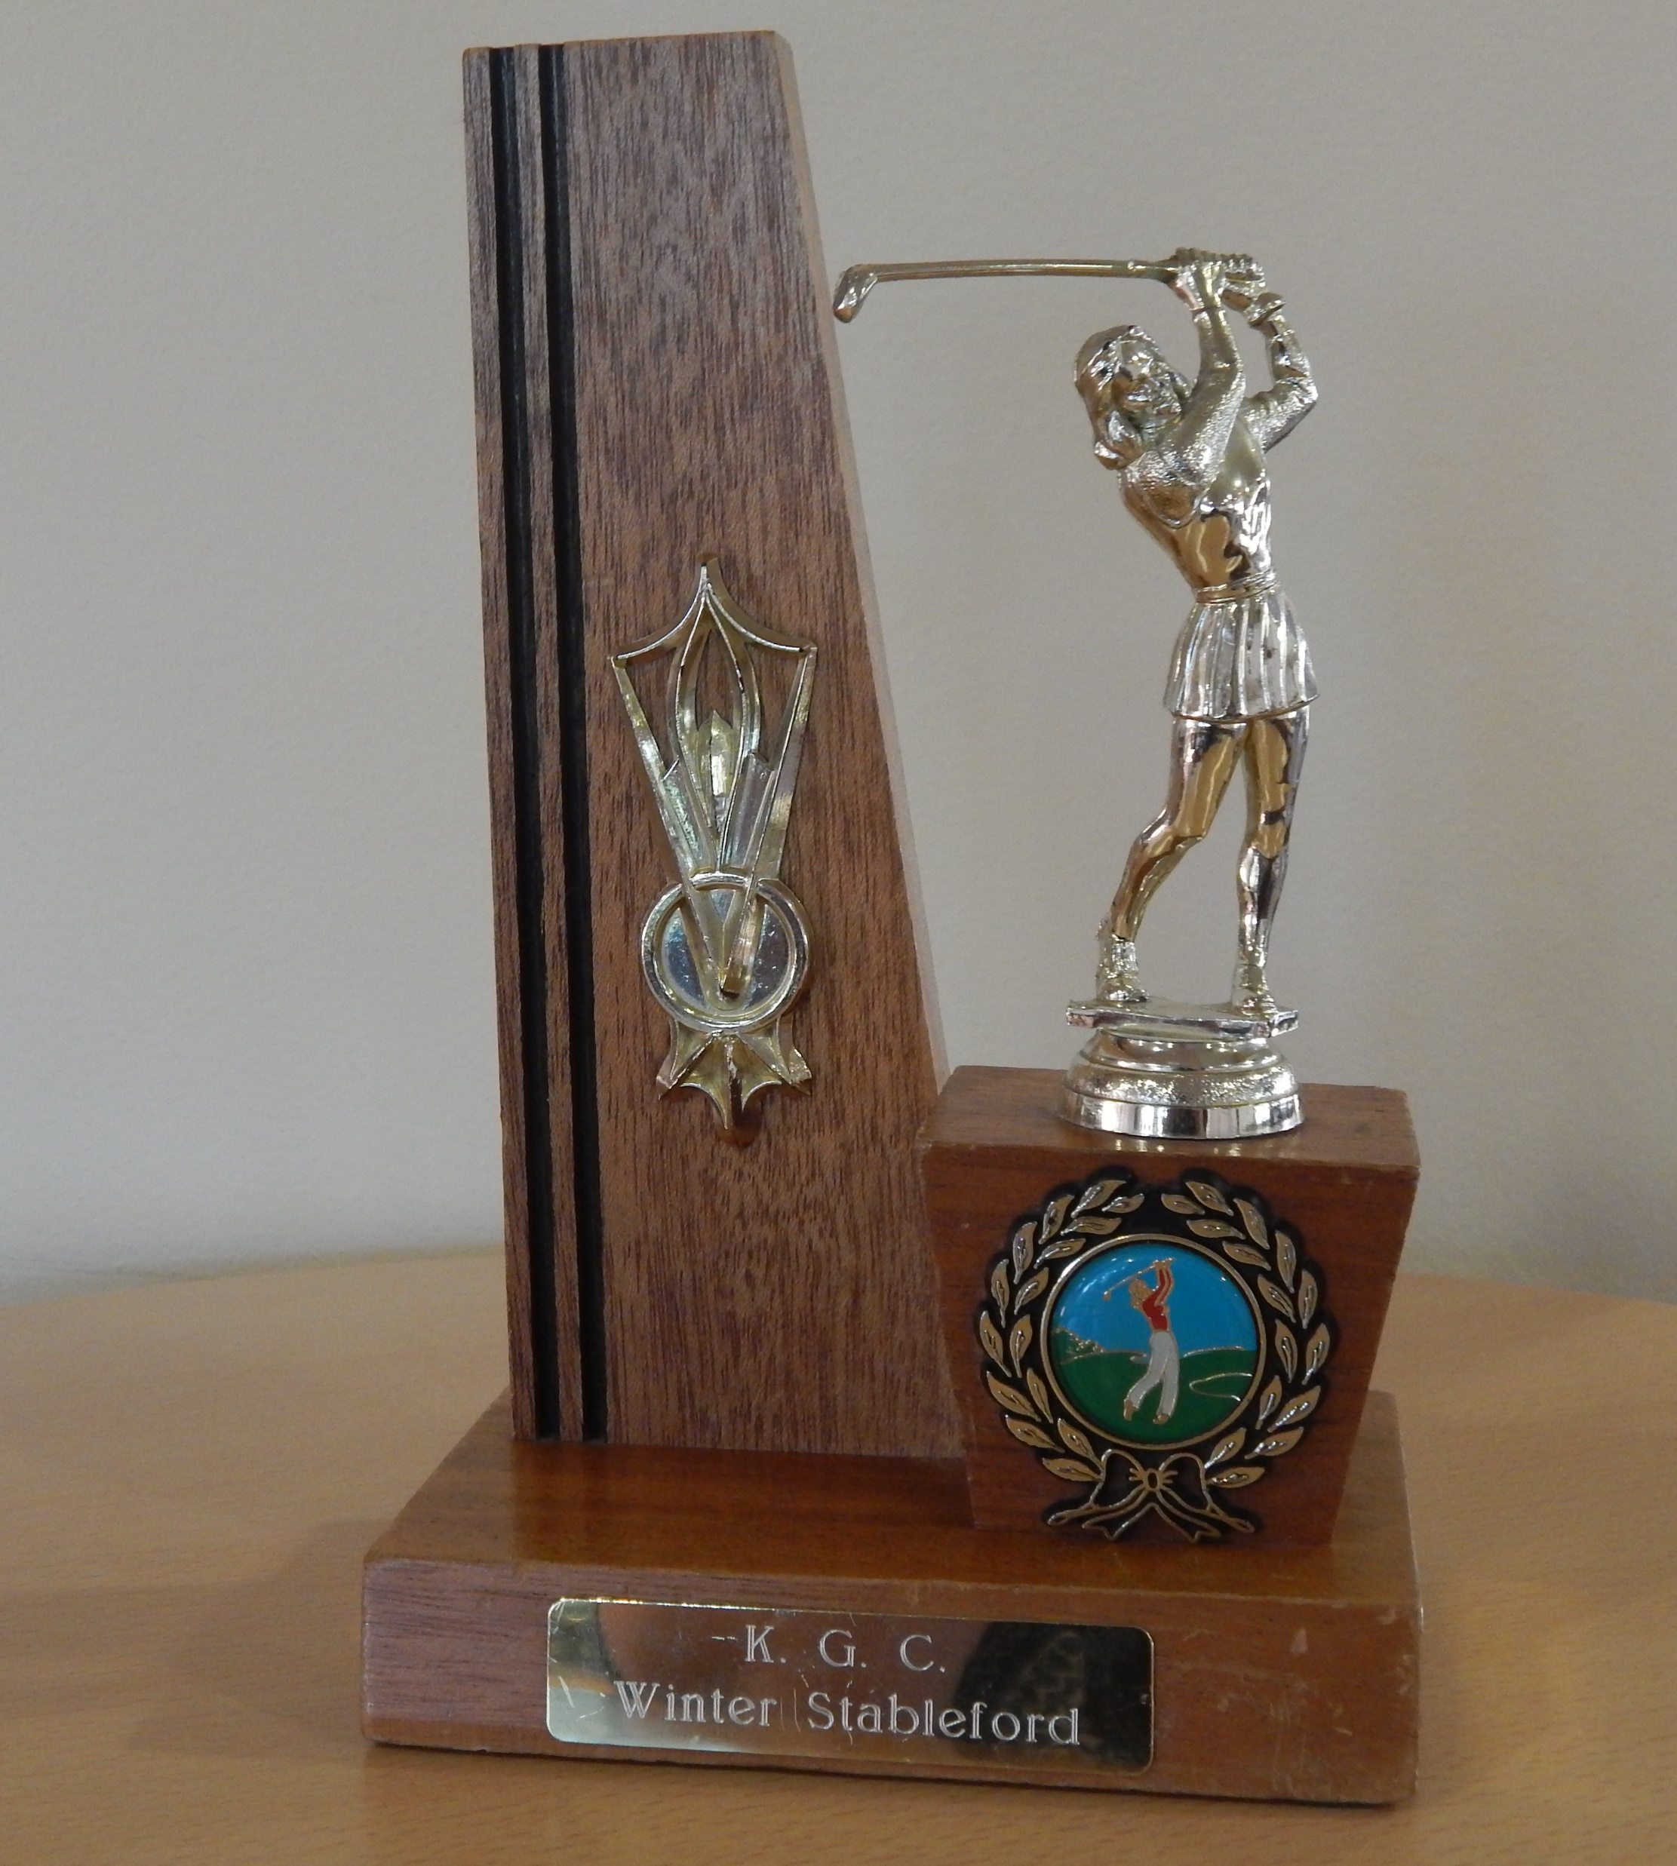
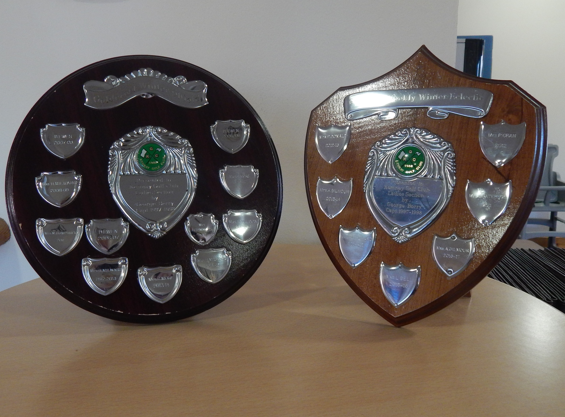
The Ladies Winter Trophies for 2019-20 were won by: Winter Shield – Peggy Donald Winter Stableford – Lynda Langlands Winter Eclectic – Heather Edgar

Slide 19
The Senior Gents Matchplay Trophy was won by Phil Murray

Slide 20
The Senior Gents Pairs Matchplay trophy was waon by Allan Strachan and Alex Jackson

Slide 21
The Senior Gents Cancer Research Trophy was won by Mike Rogers

Slide 22
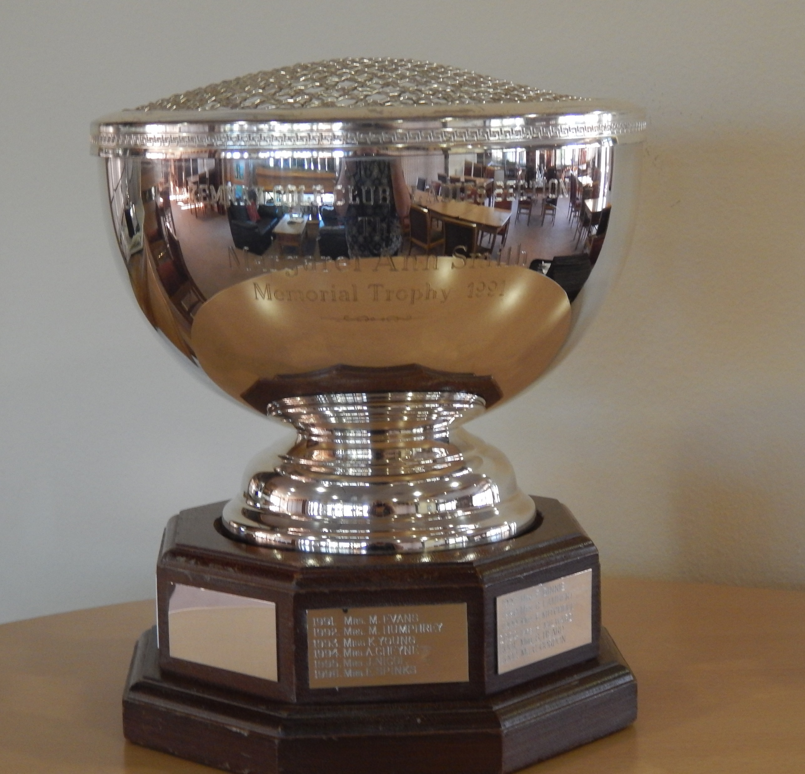
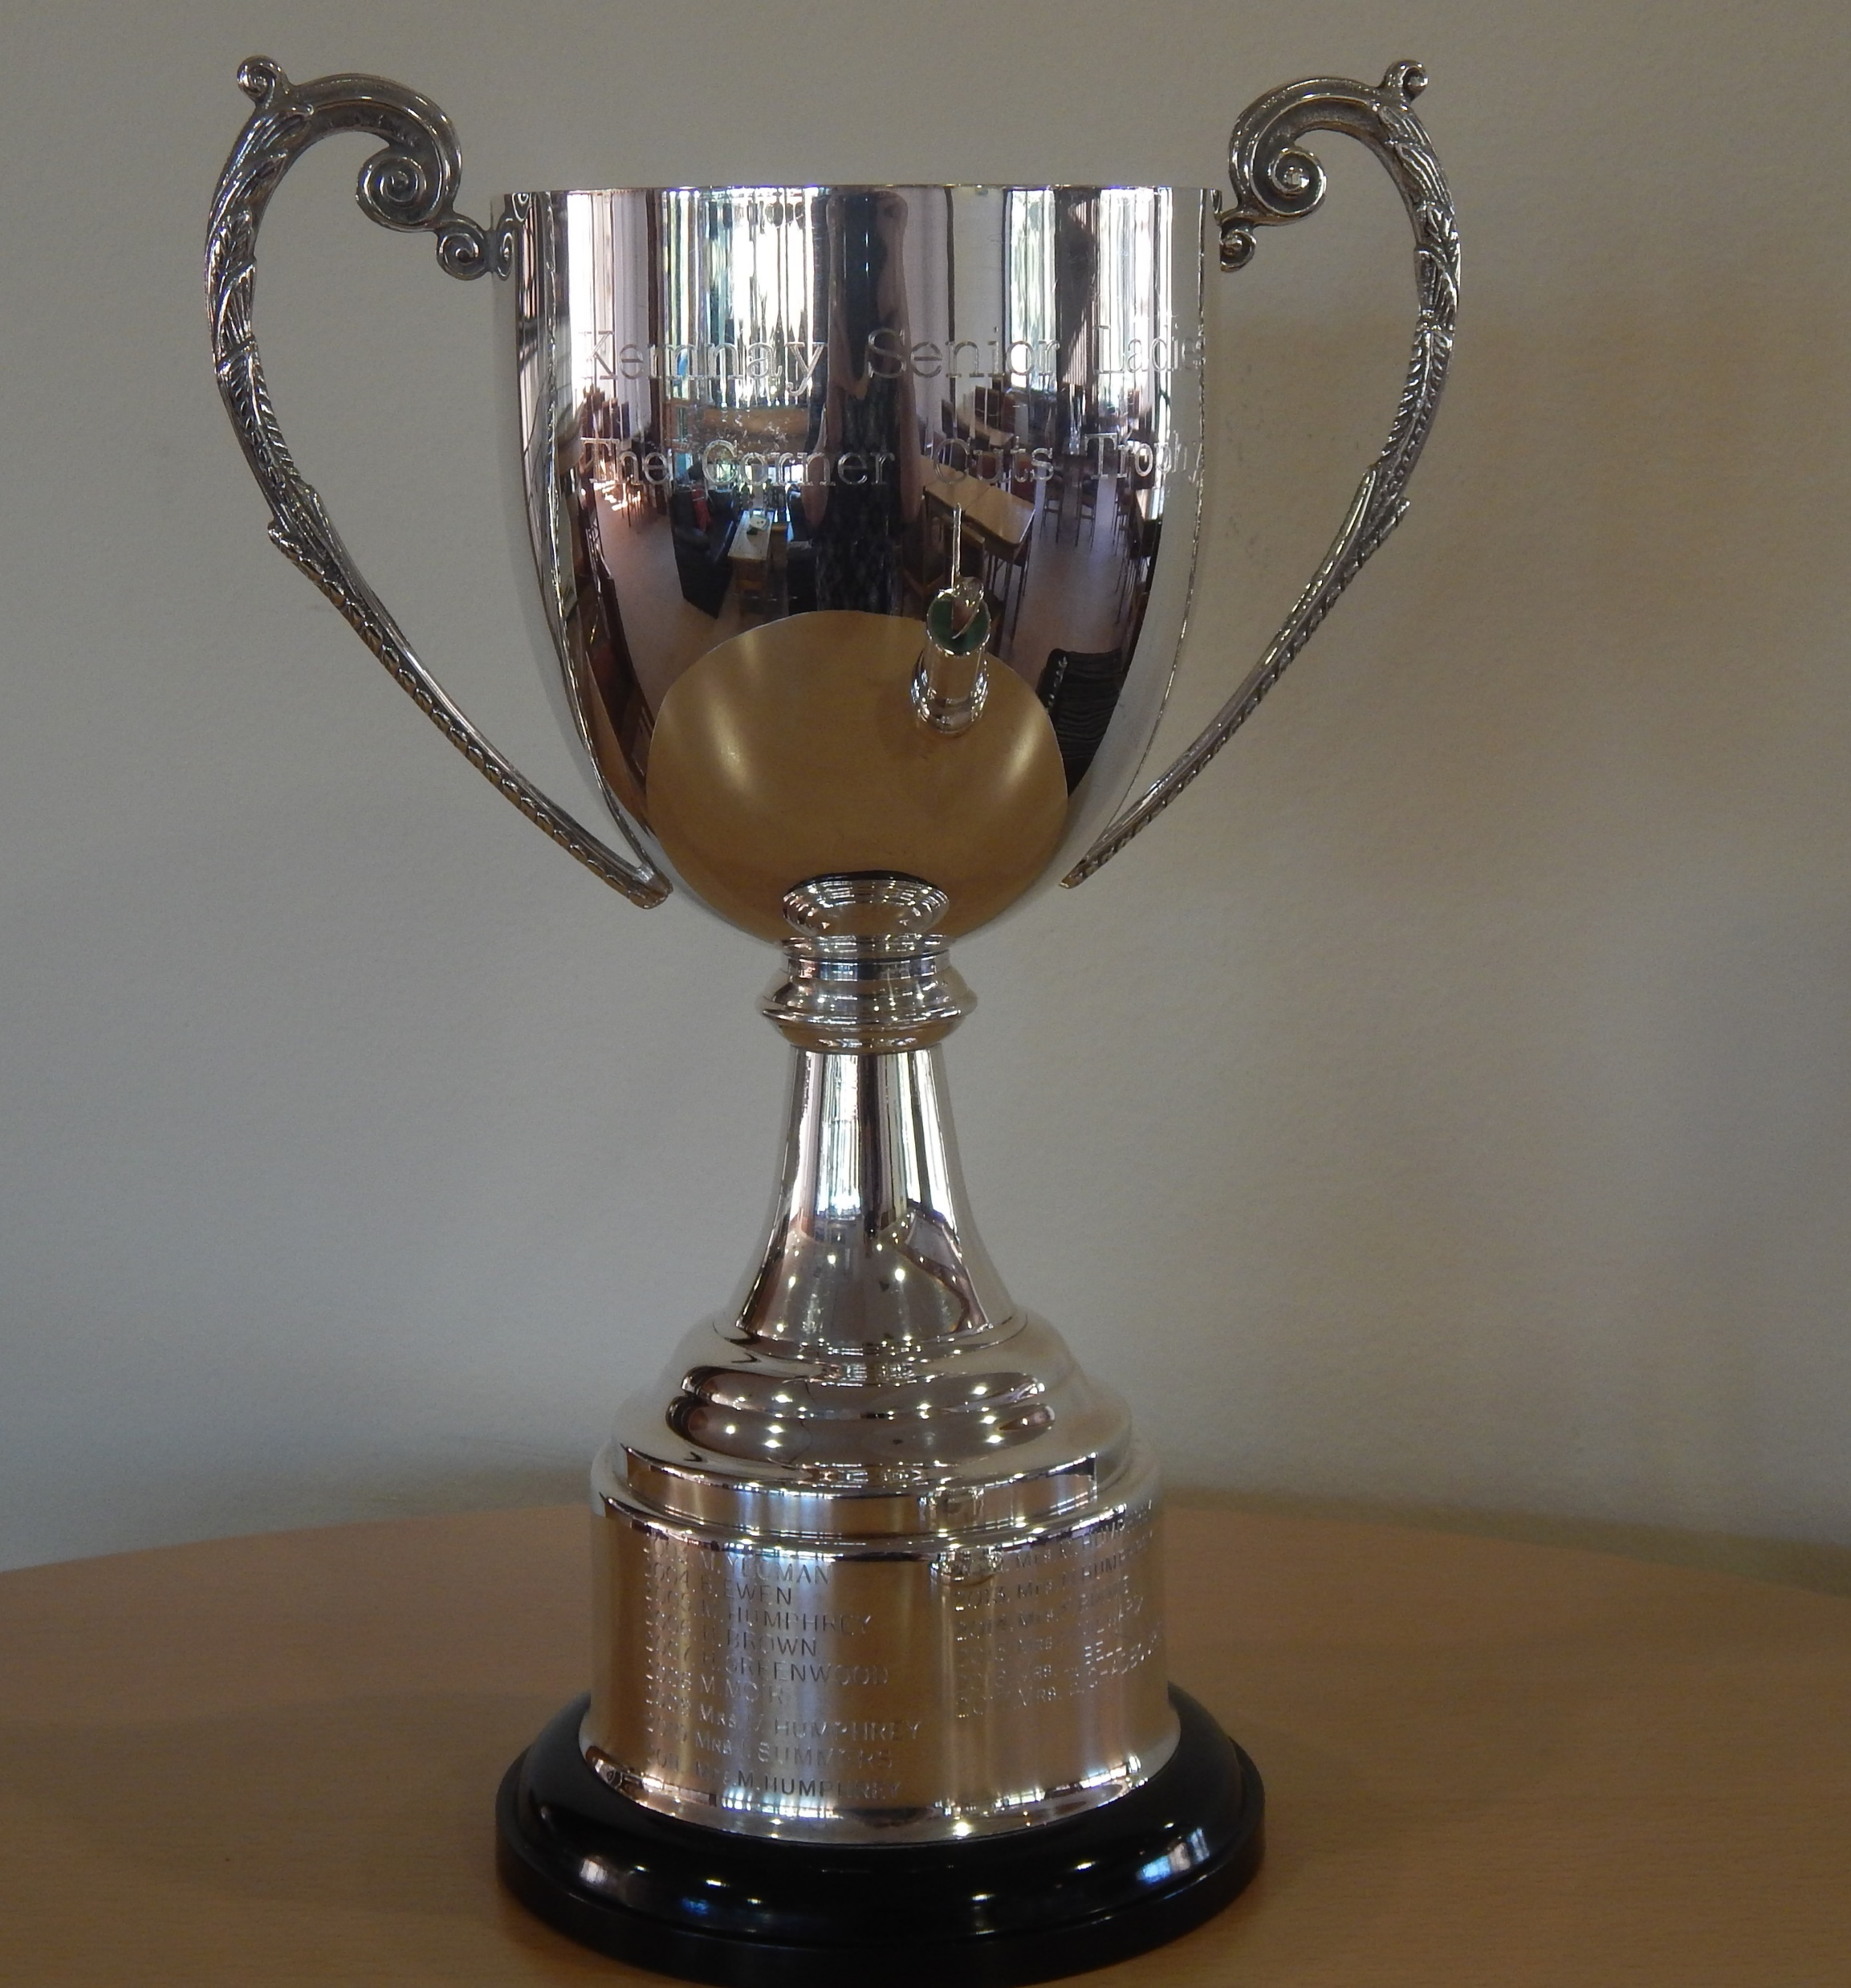
Lynda Langlands won the Margaret Smith Rosebowl for the most improved Lady player in 2020. Lynda also won the Senior Ladies Corner Cuts Trophy

Slide 23
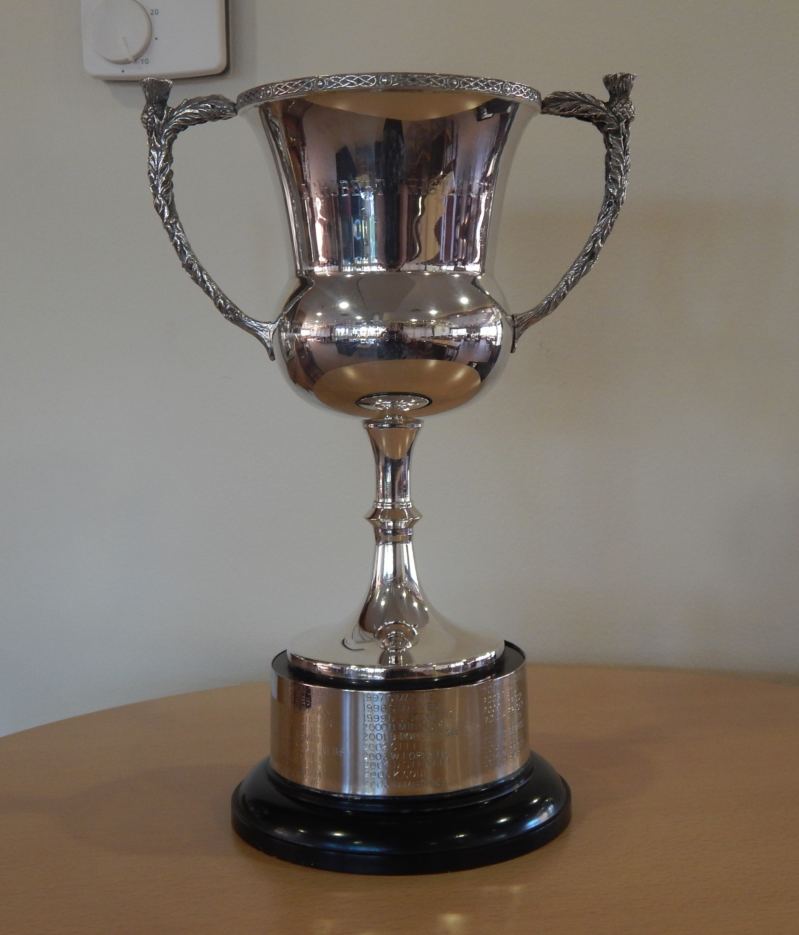
New member Ross Simpson won the McRobert Stableford Trophy

Slide 24
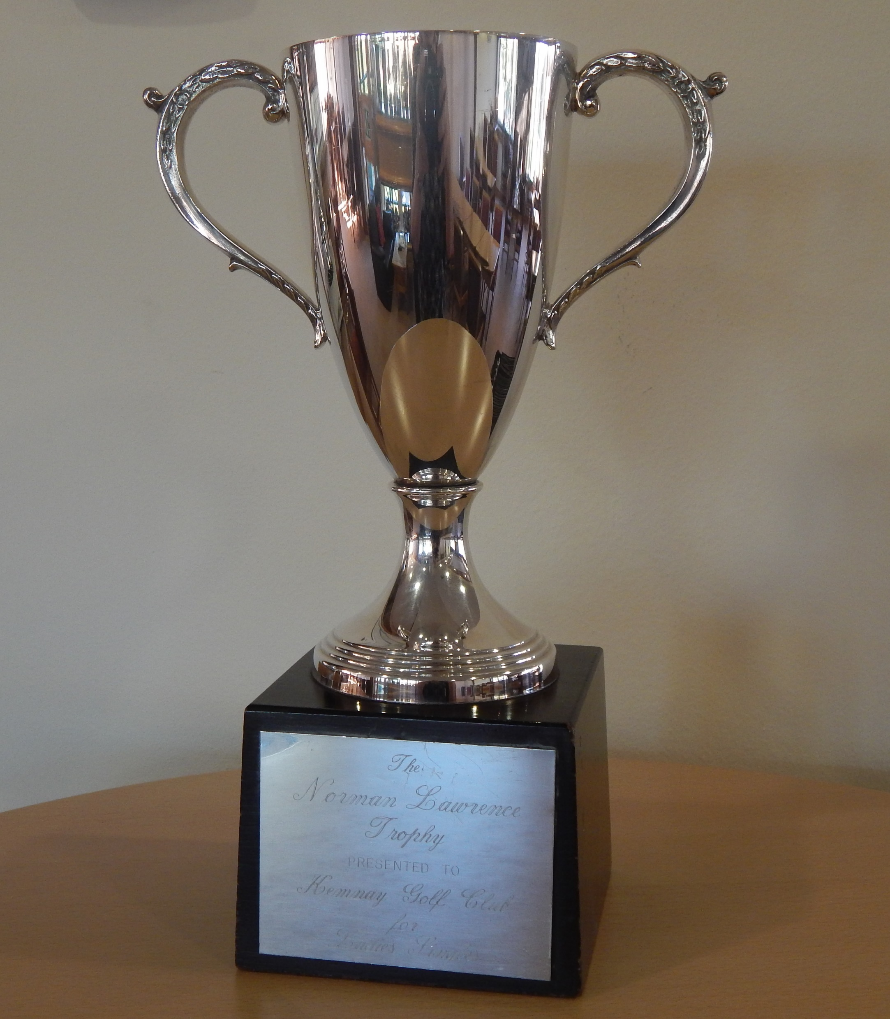
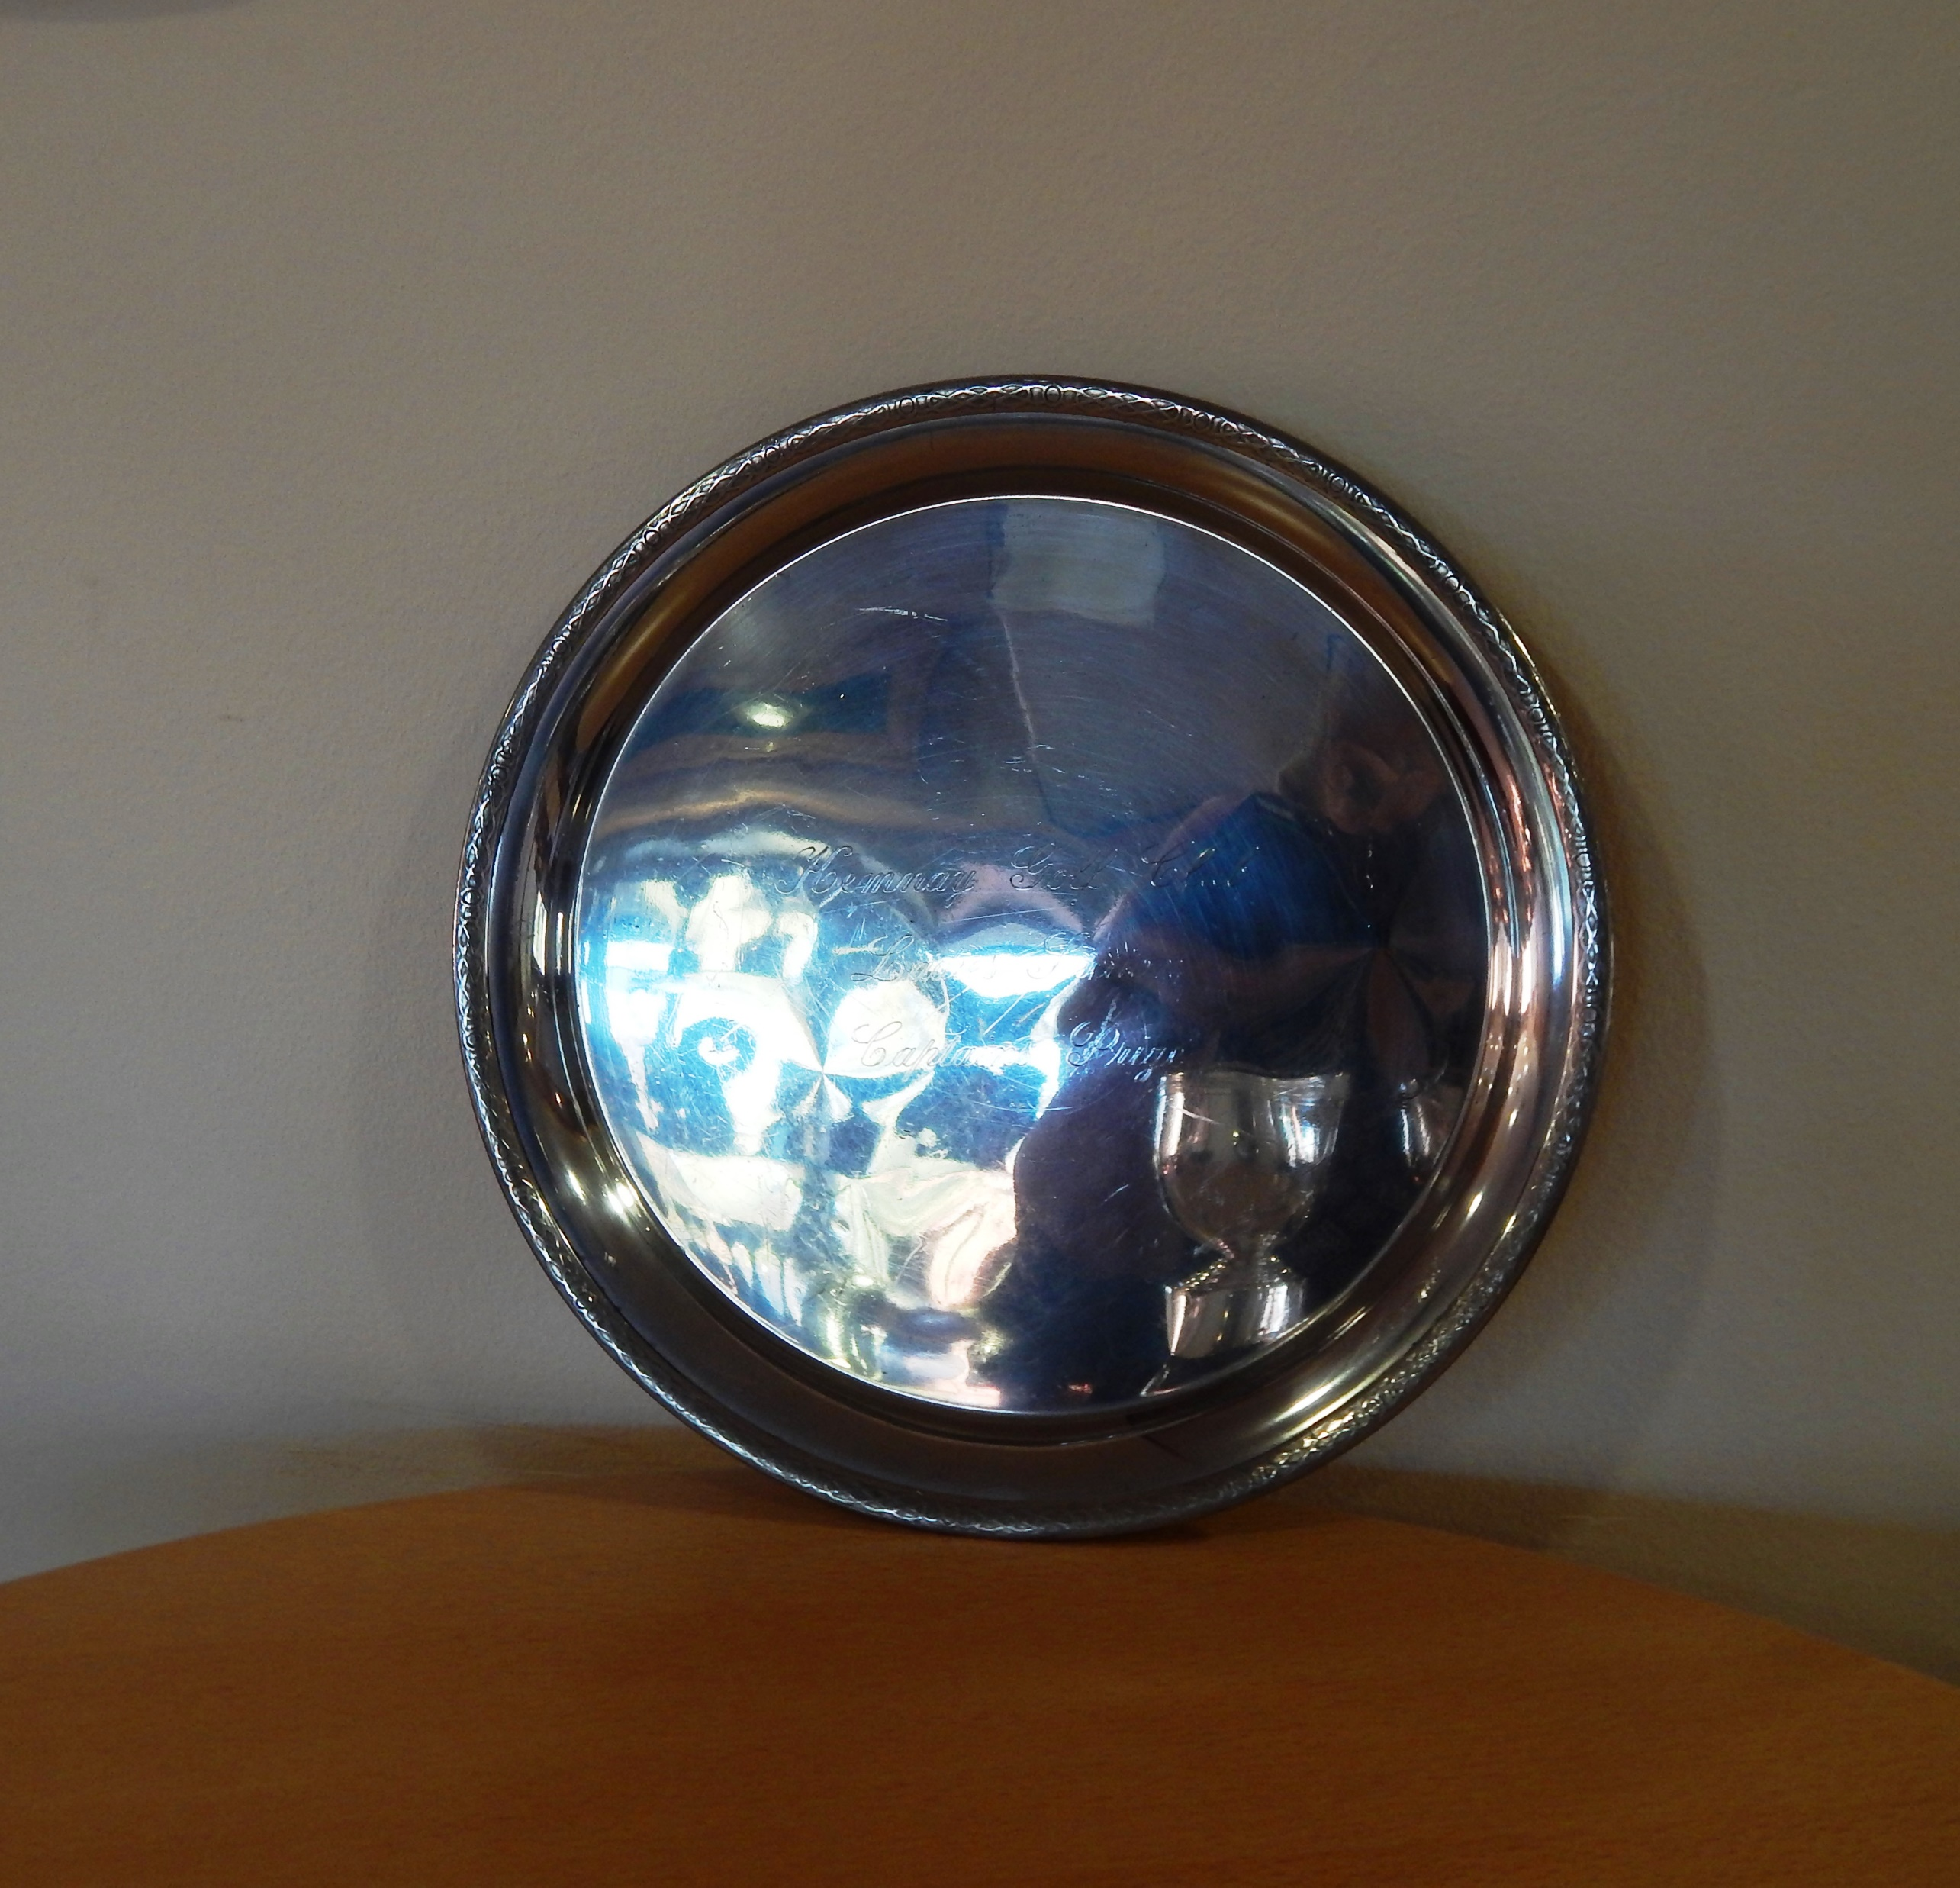
Fiona Pennie won the Captains Prize and the Norman Lawrence Stableford Trophy

Slide 25
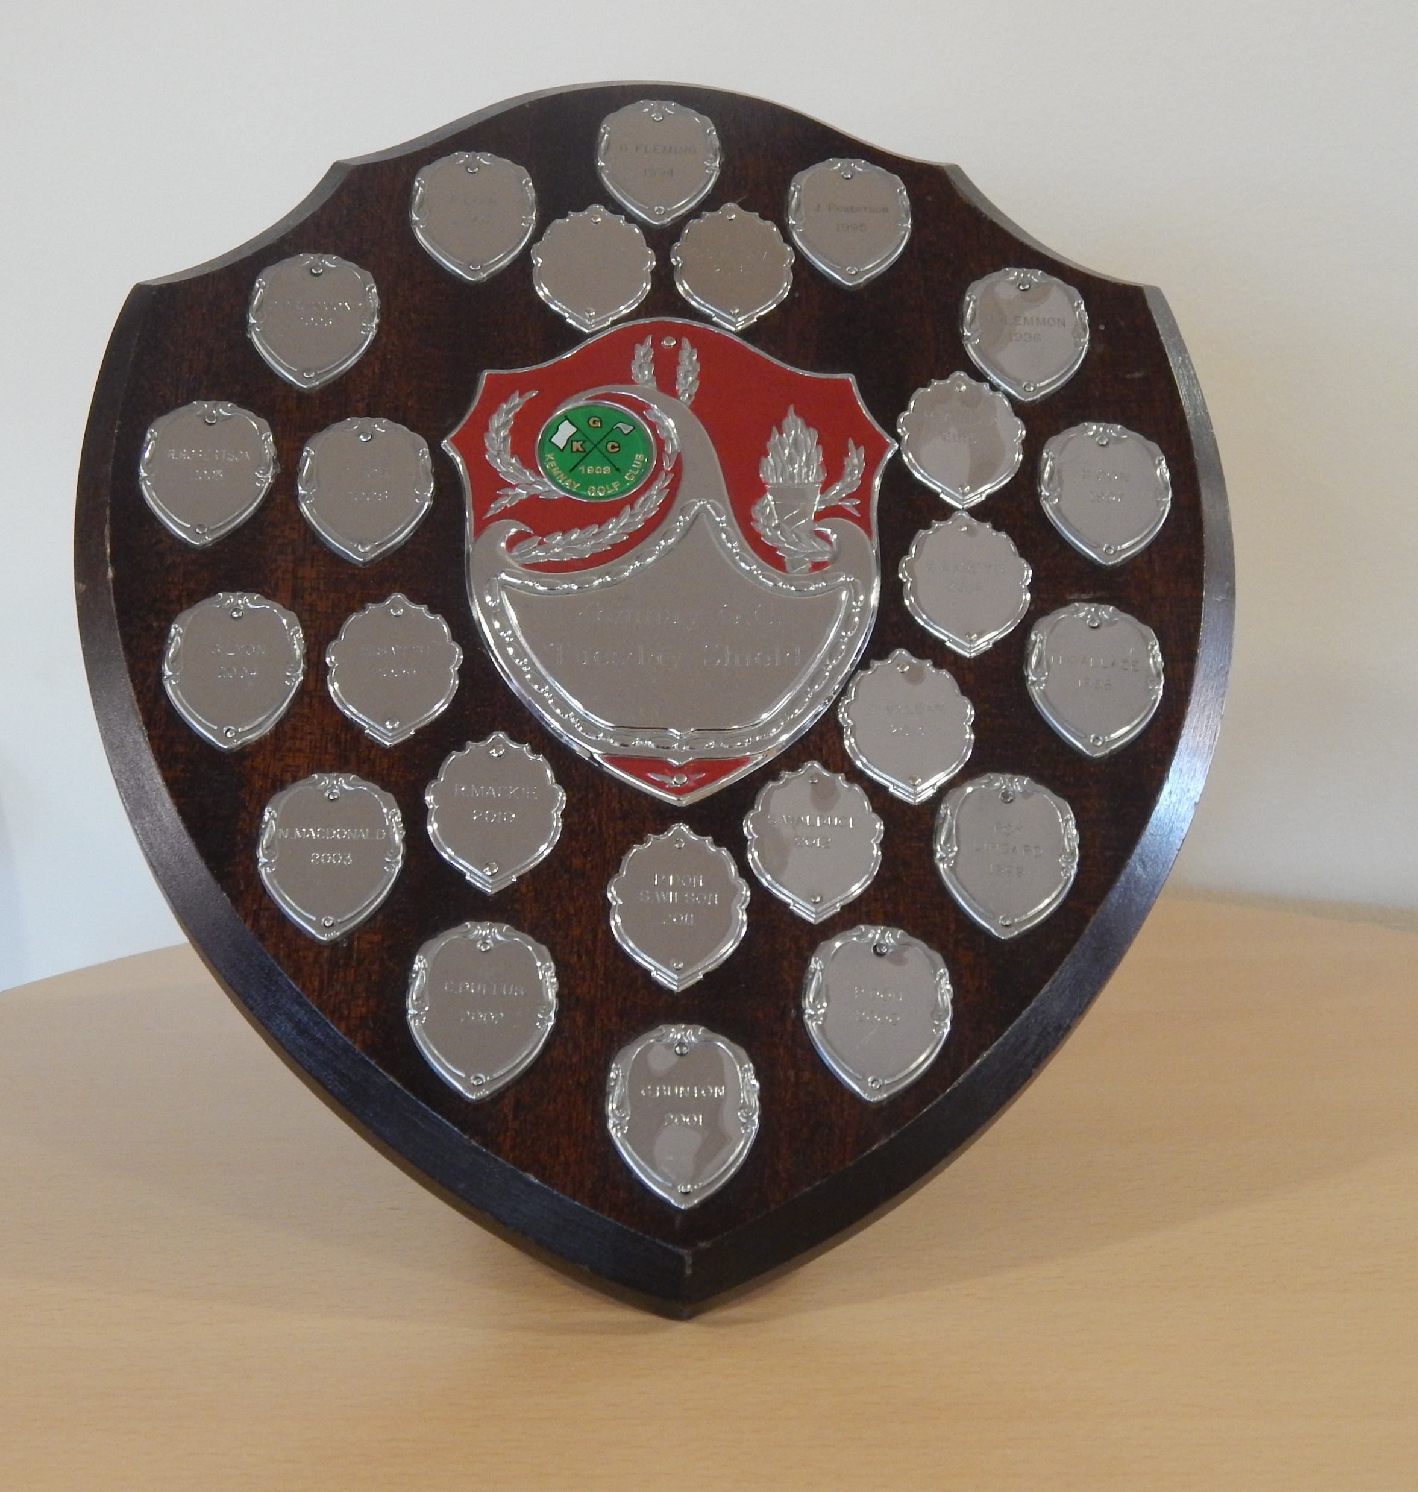
Darren Eggie won the Tuesday Shield

Slide 26
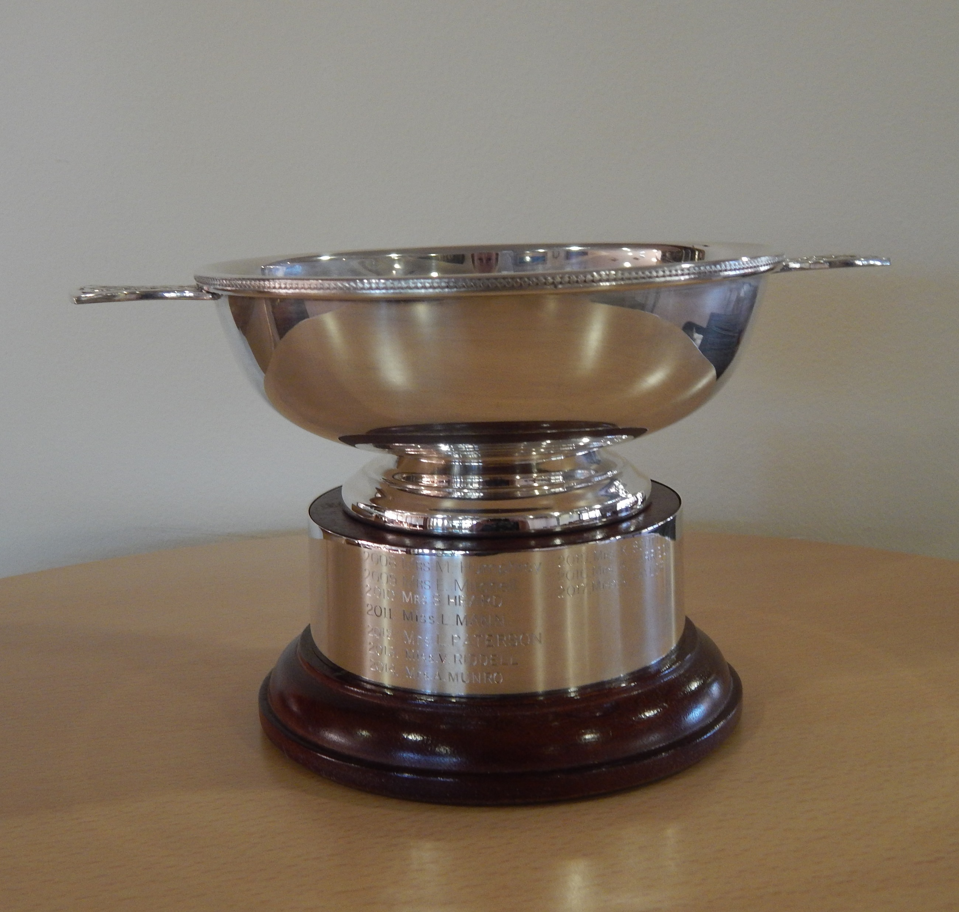
Beth Forbes won the Centenary Strokeplay Trophy

Slide 27
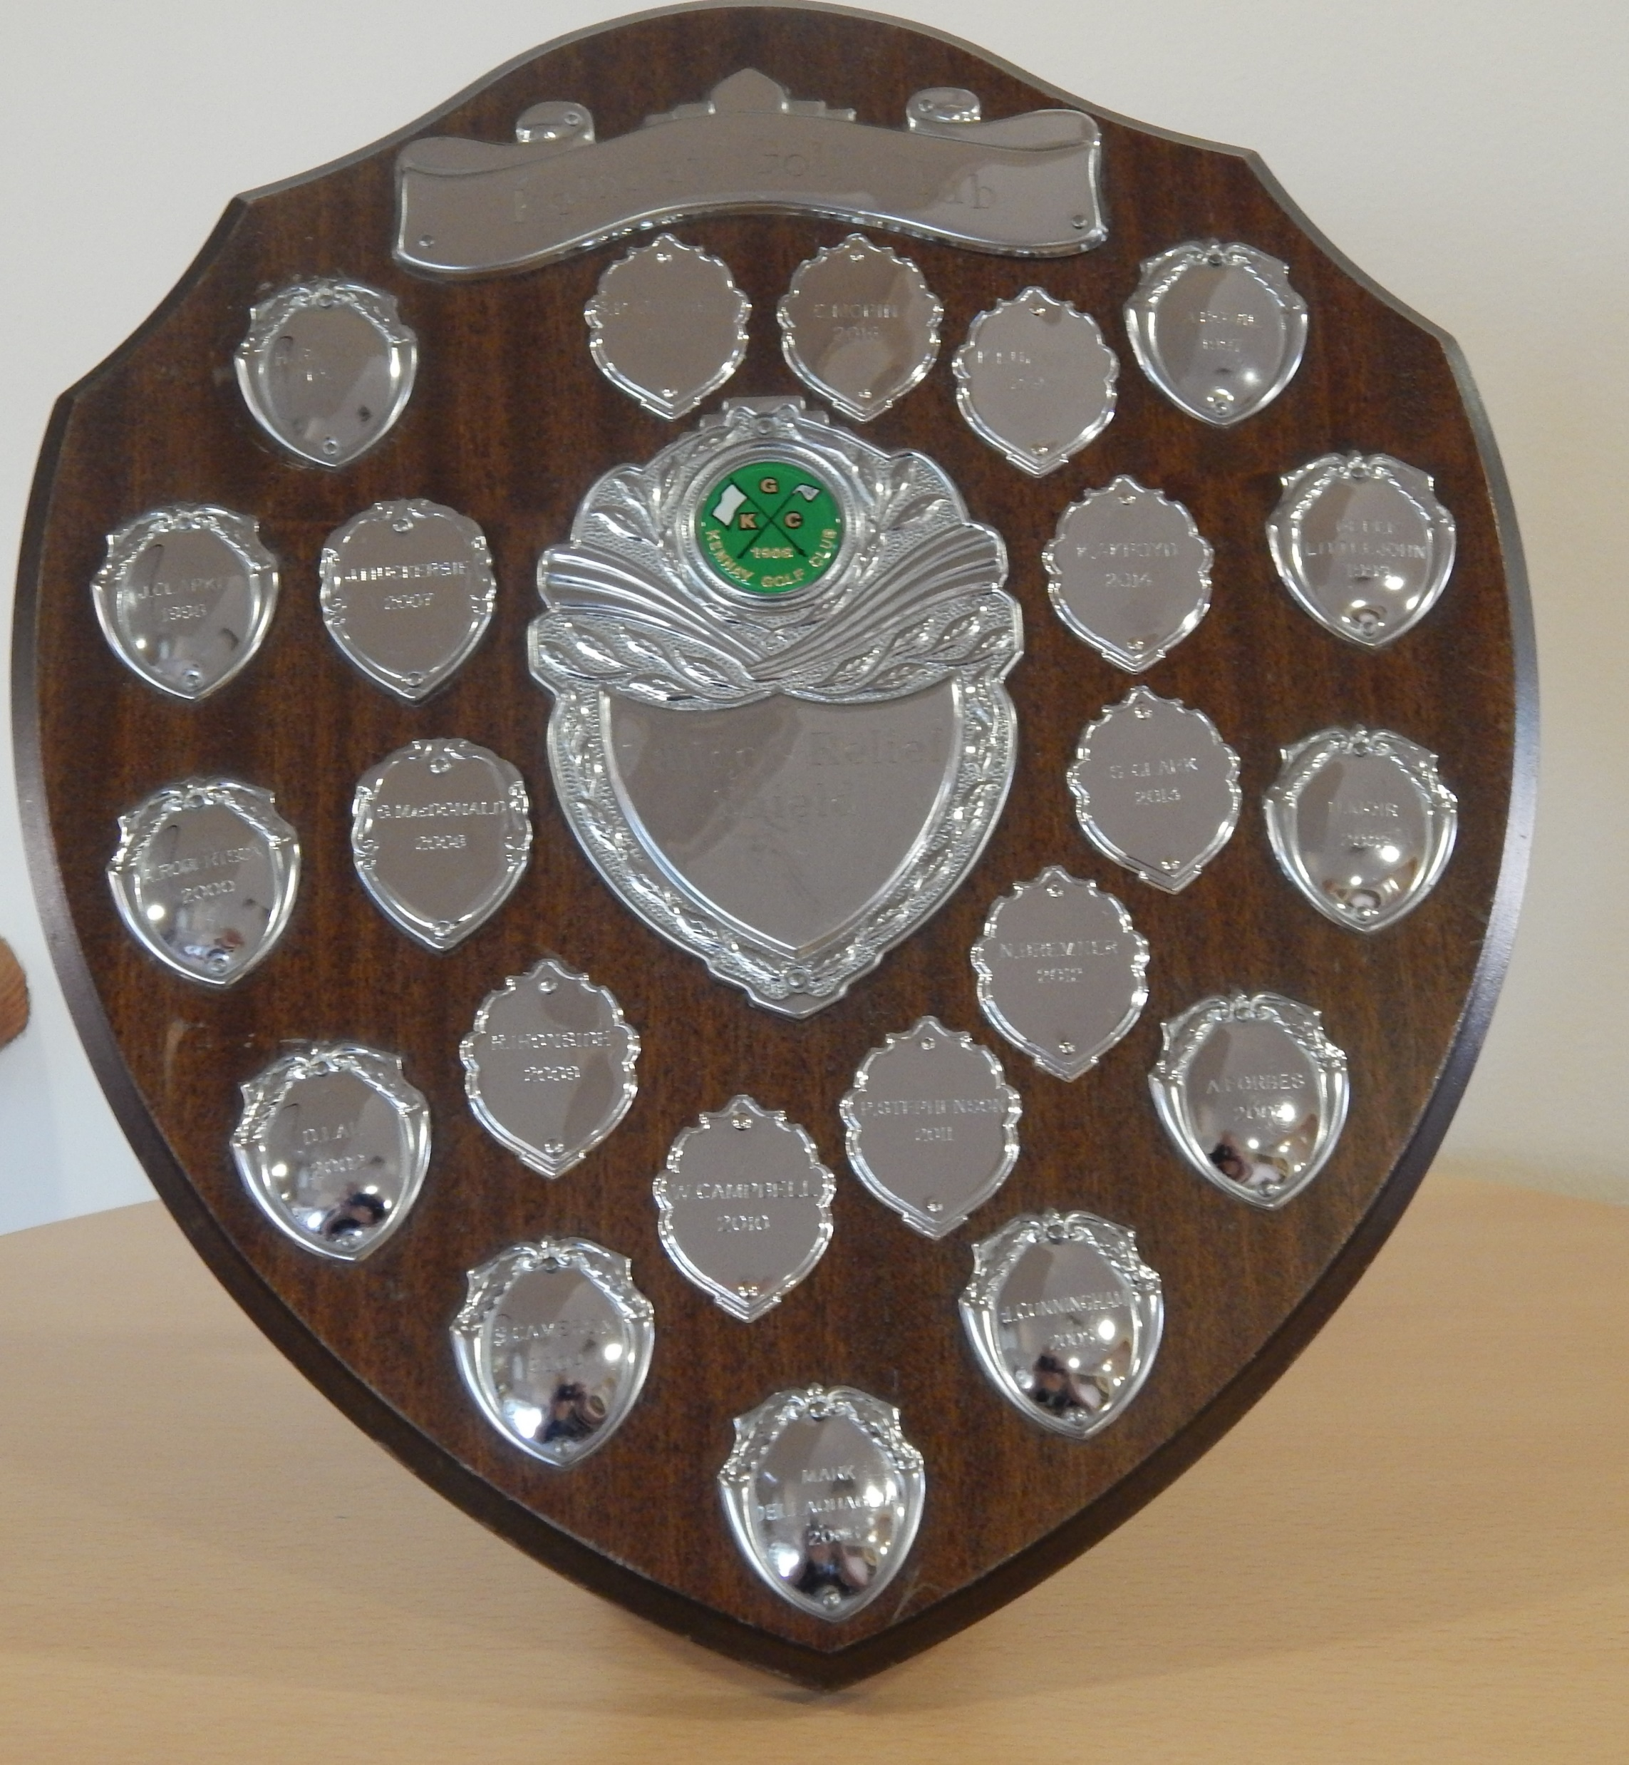
Steven Hay won the Cancer Relief Shield

Slide 28
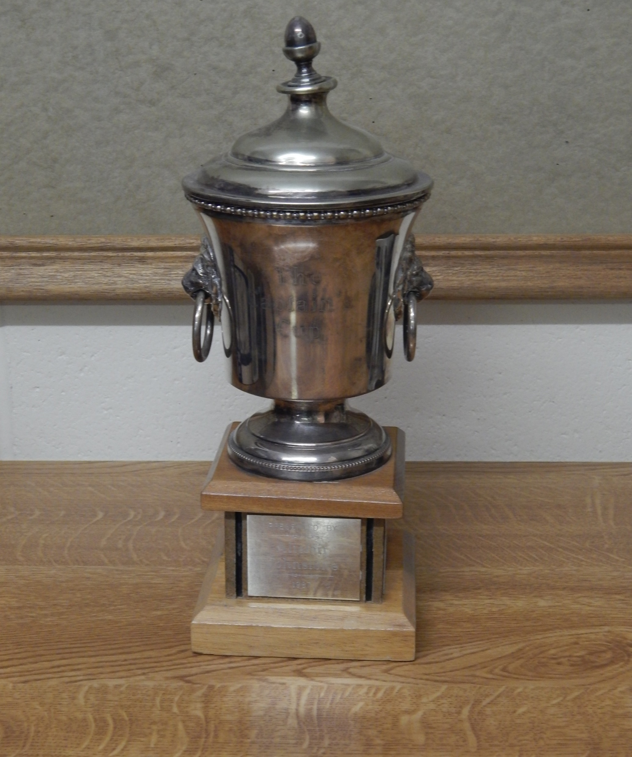
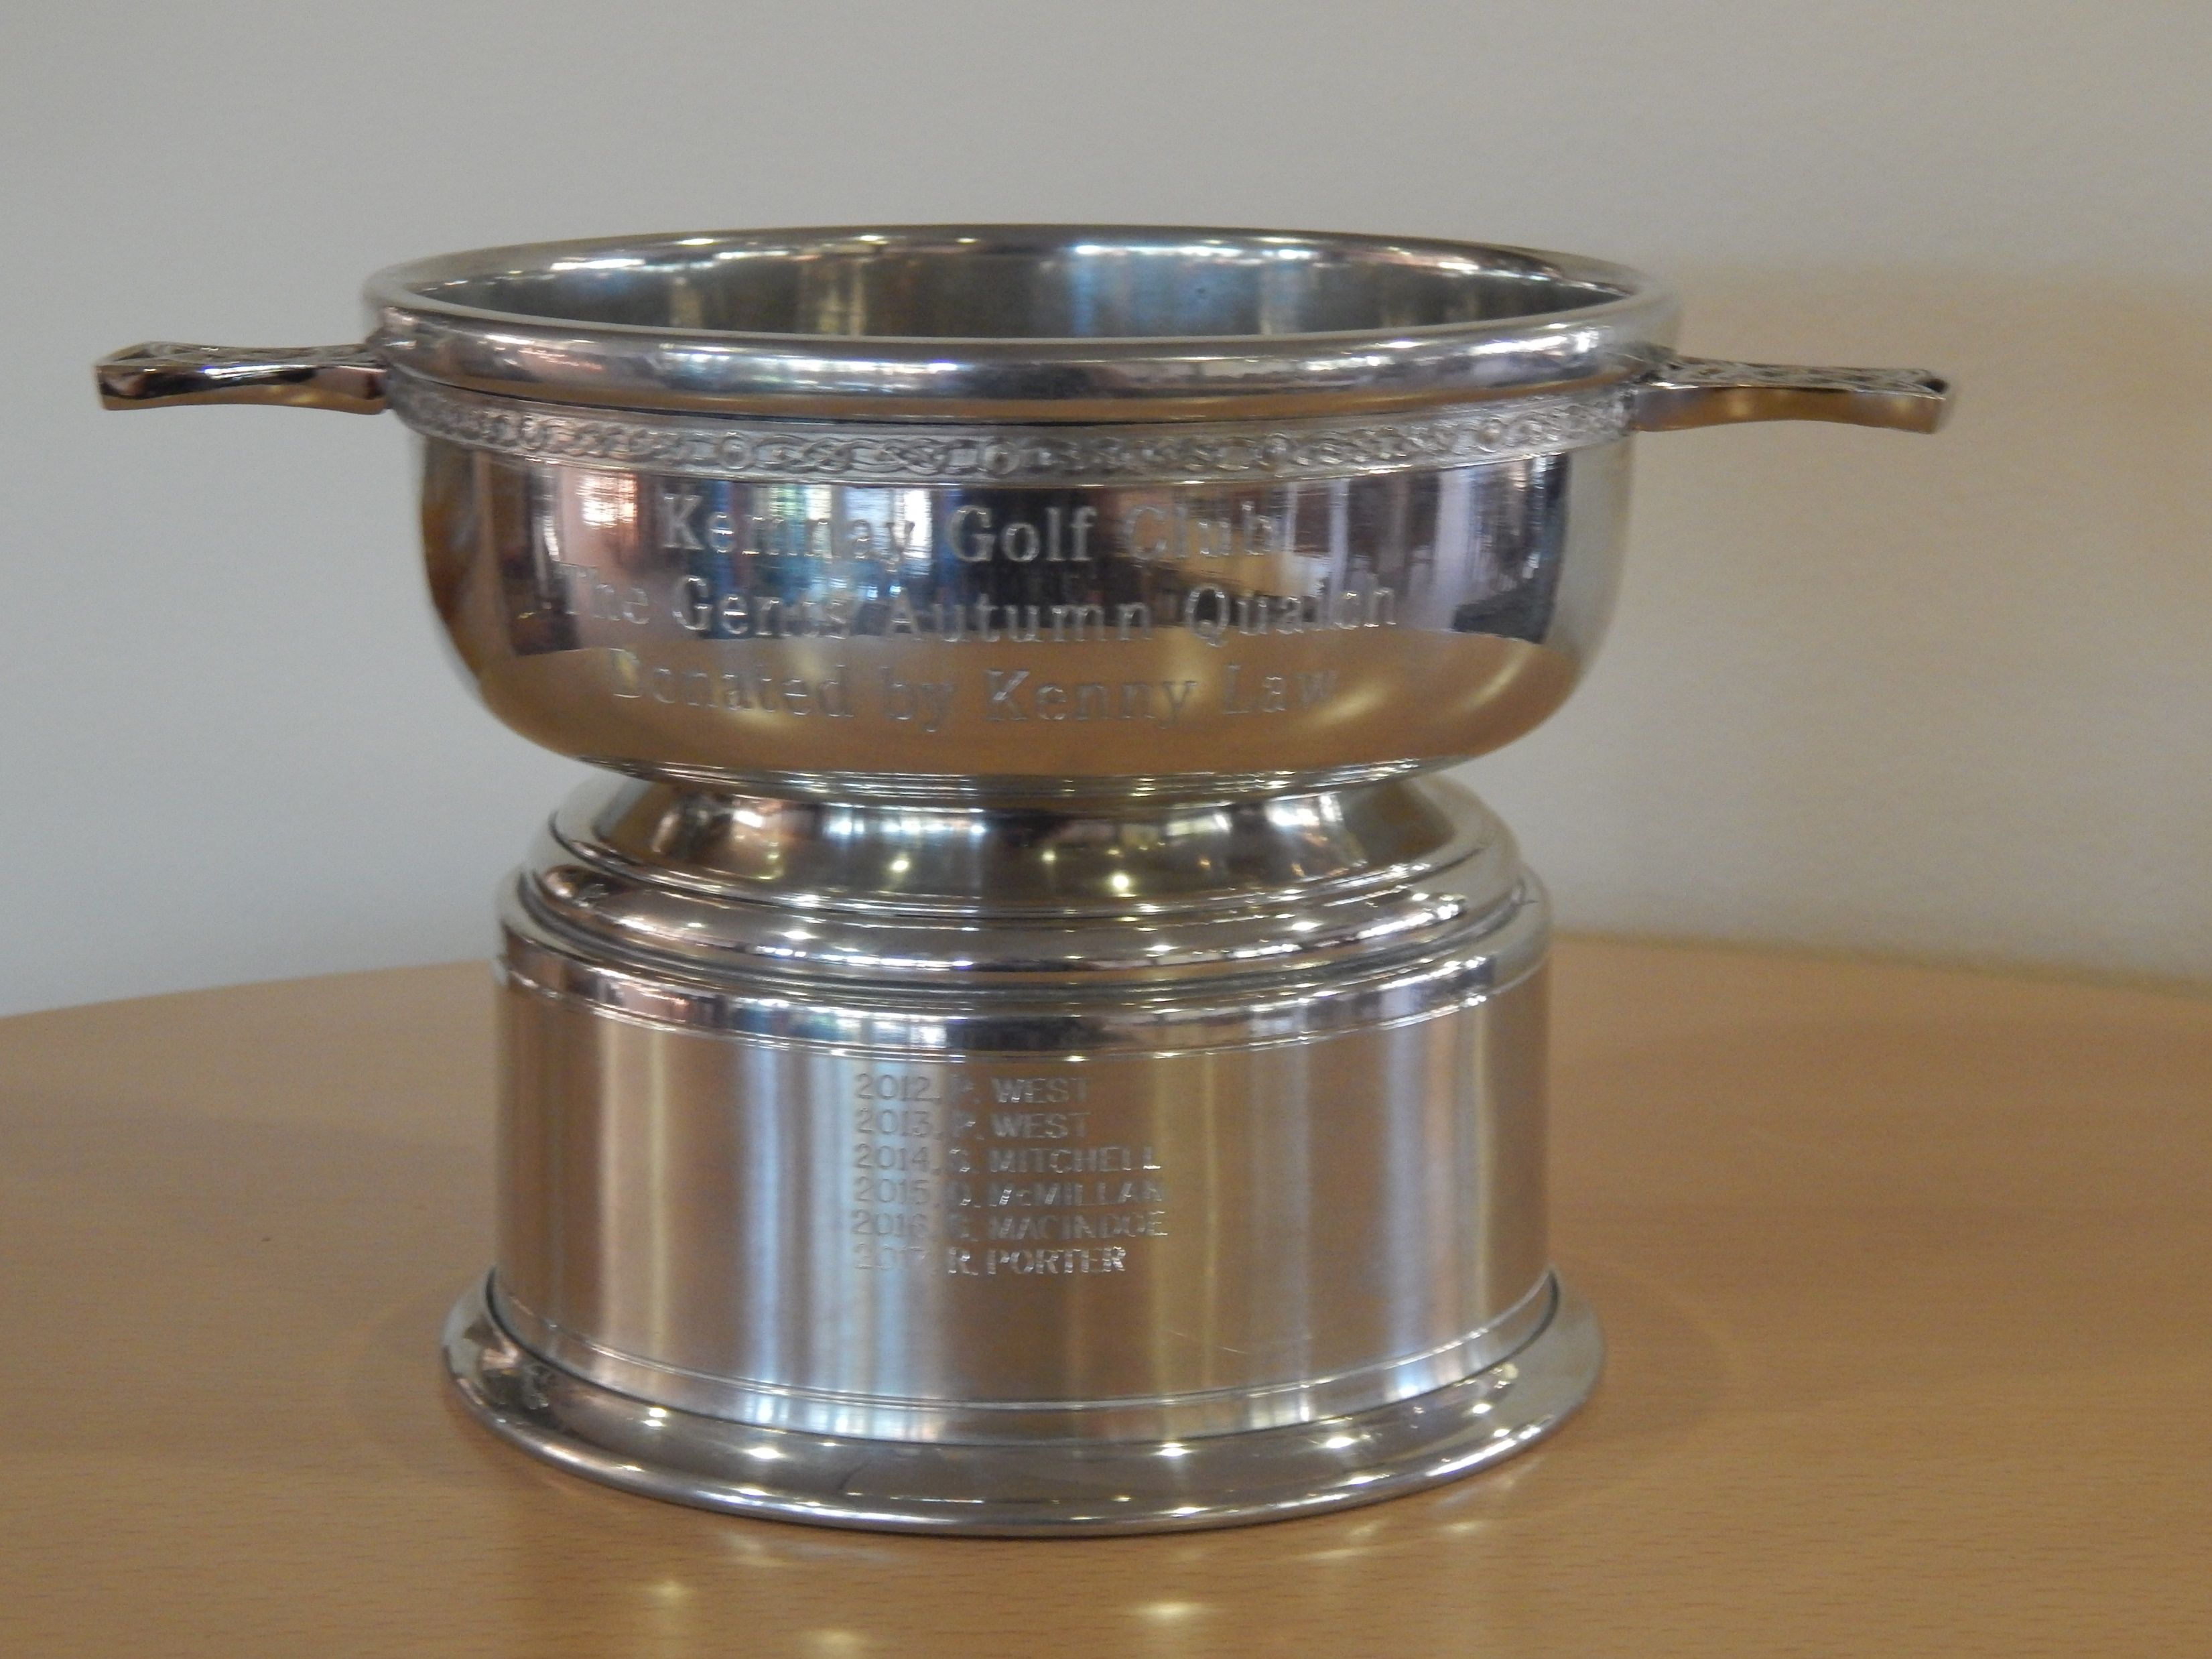
Fraser Laird, our Youth Champion, also won the Captains Cup and Autumn Quaich

Slide 29
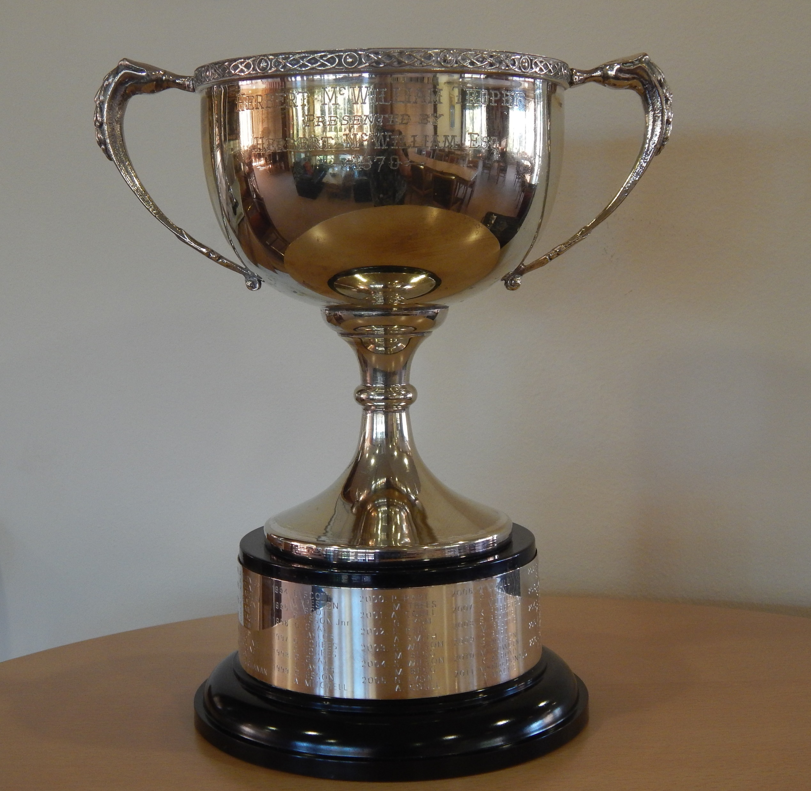
Russell Pennie and Allan Milne won the Herbert McWilliam Pairs Trophy

Slide 30
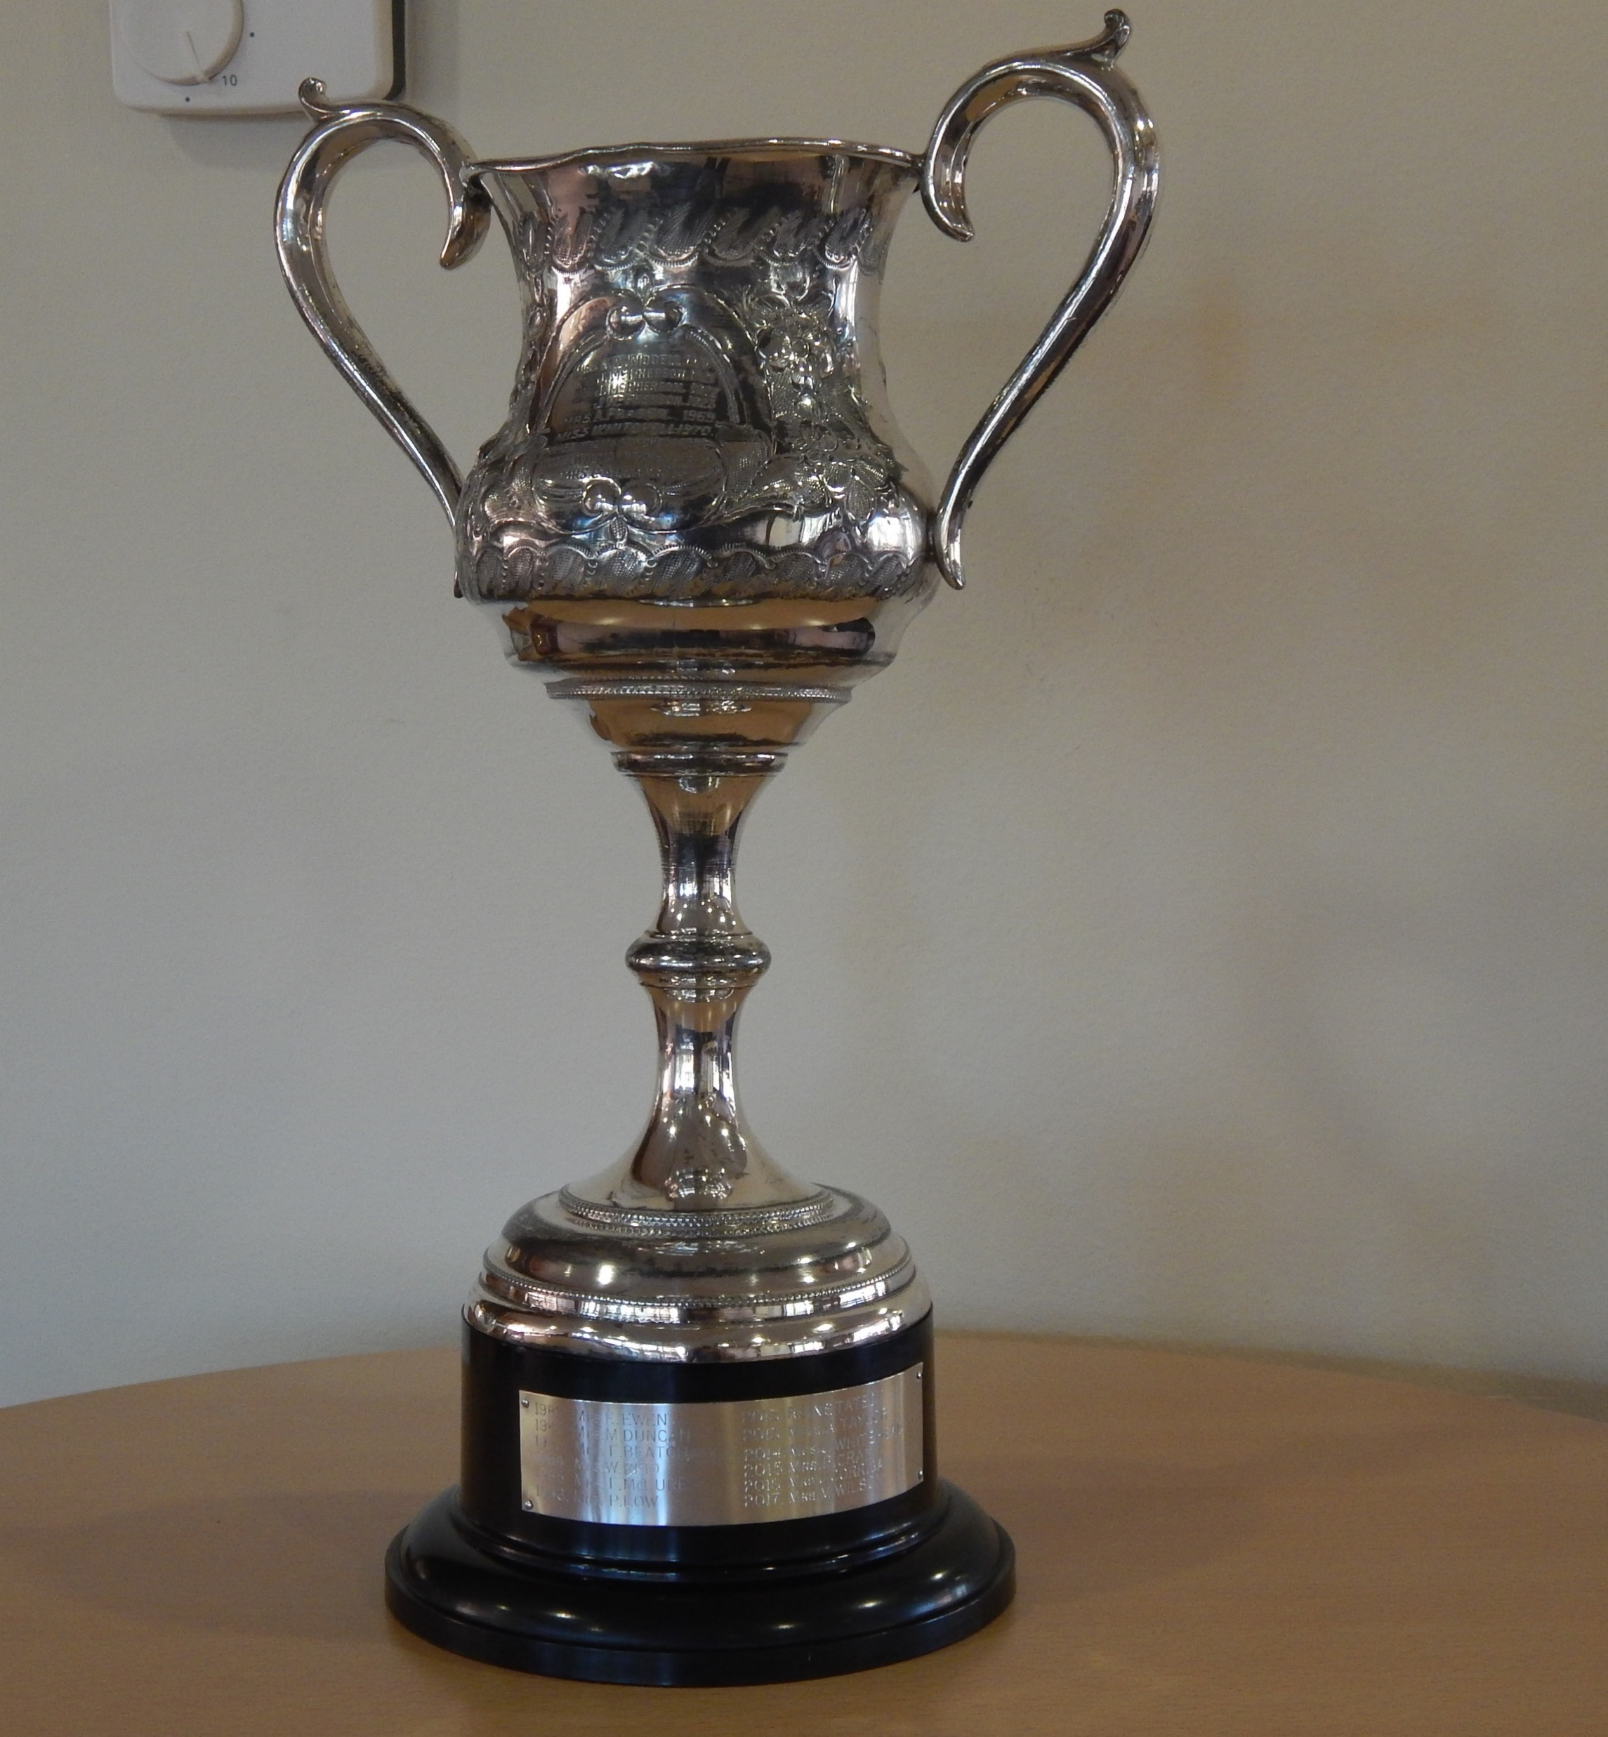
Allie Taylor won the Janet McPherson Trophy

Slide 31
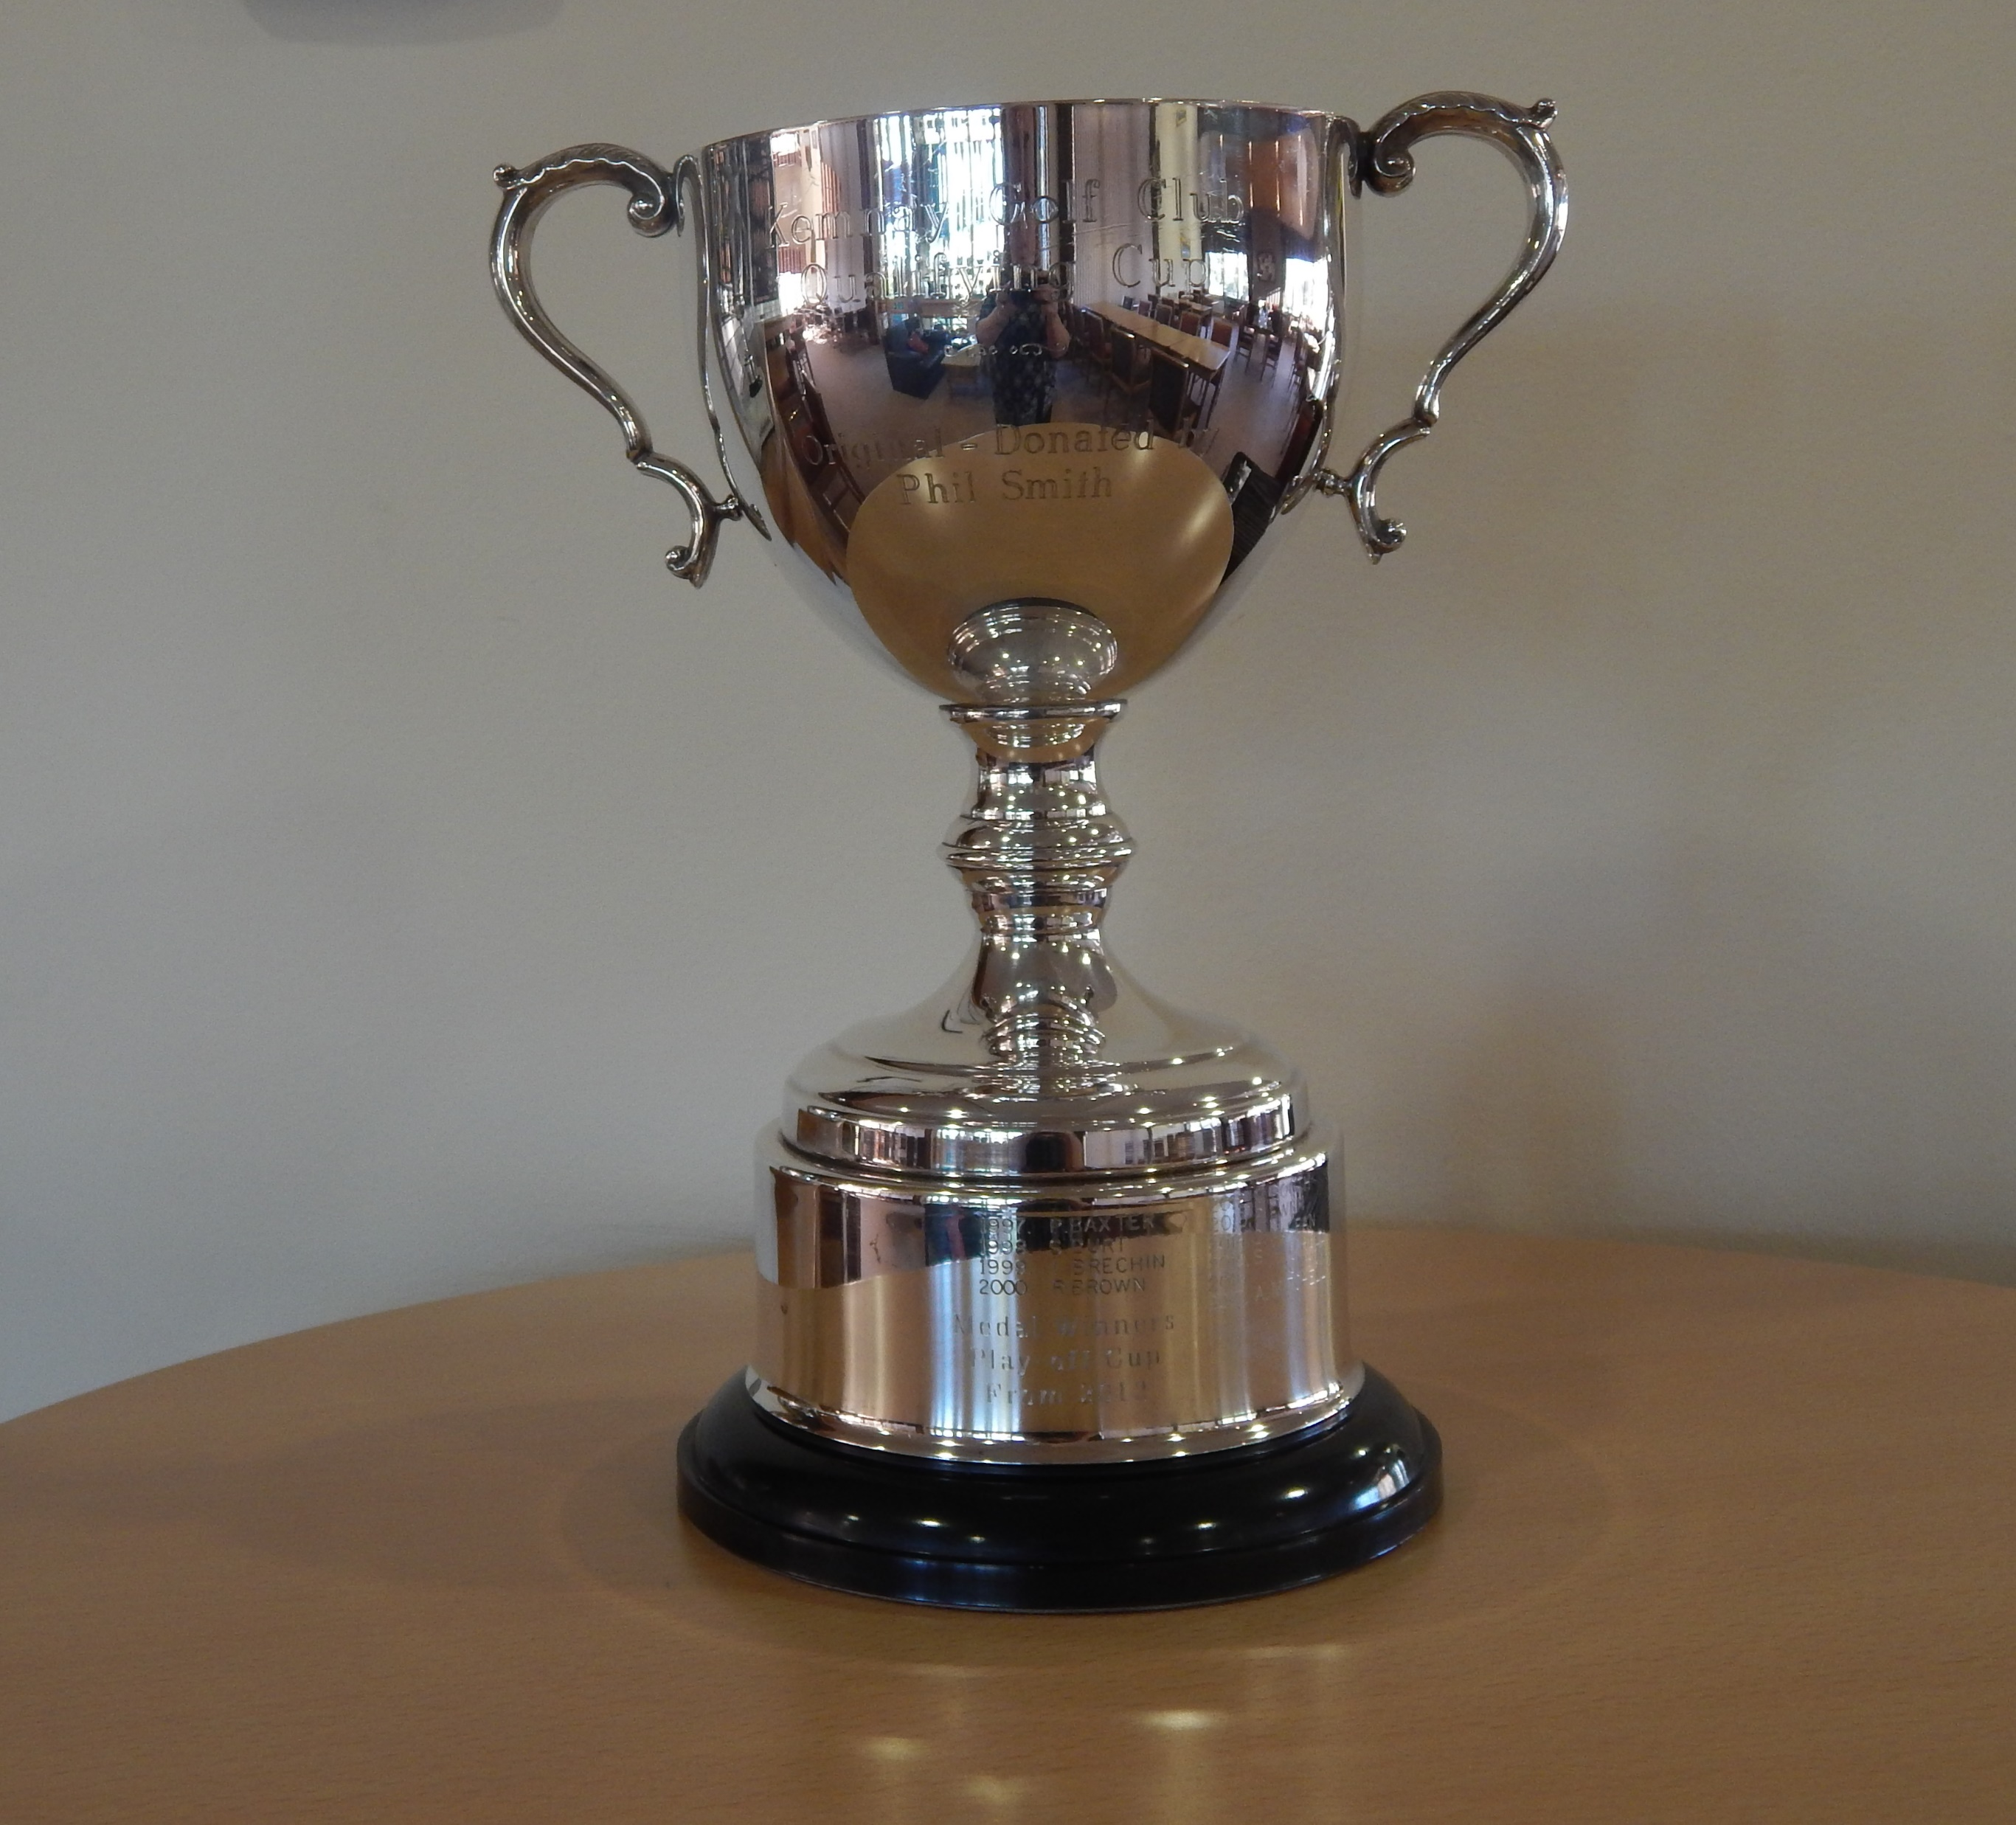
Graham Black won the Gents Order of Merit and the Medal Winners Qualifying Cup

Slide 32
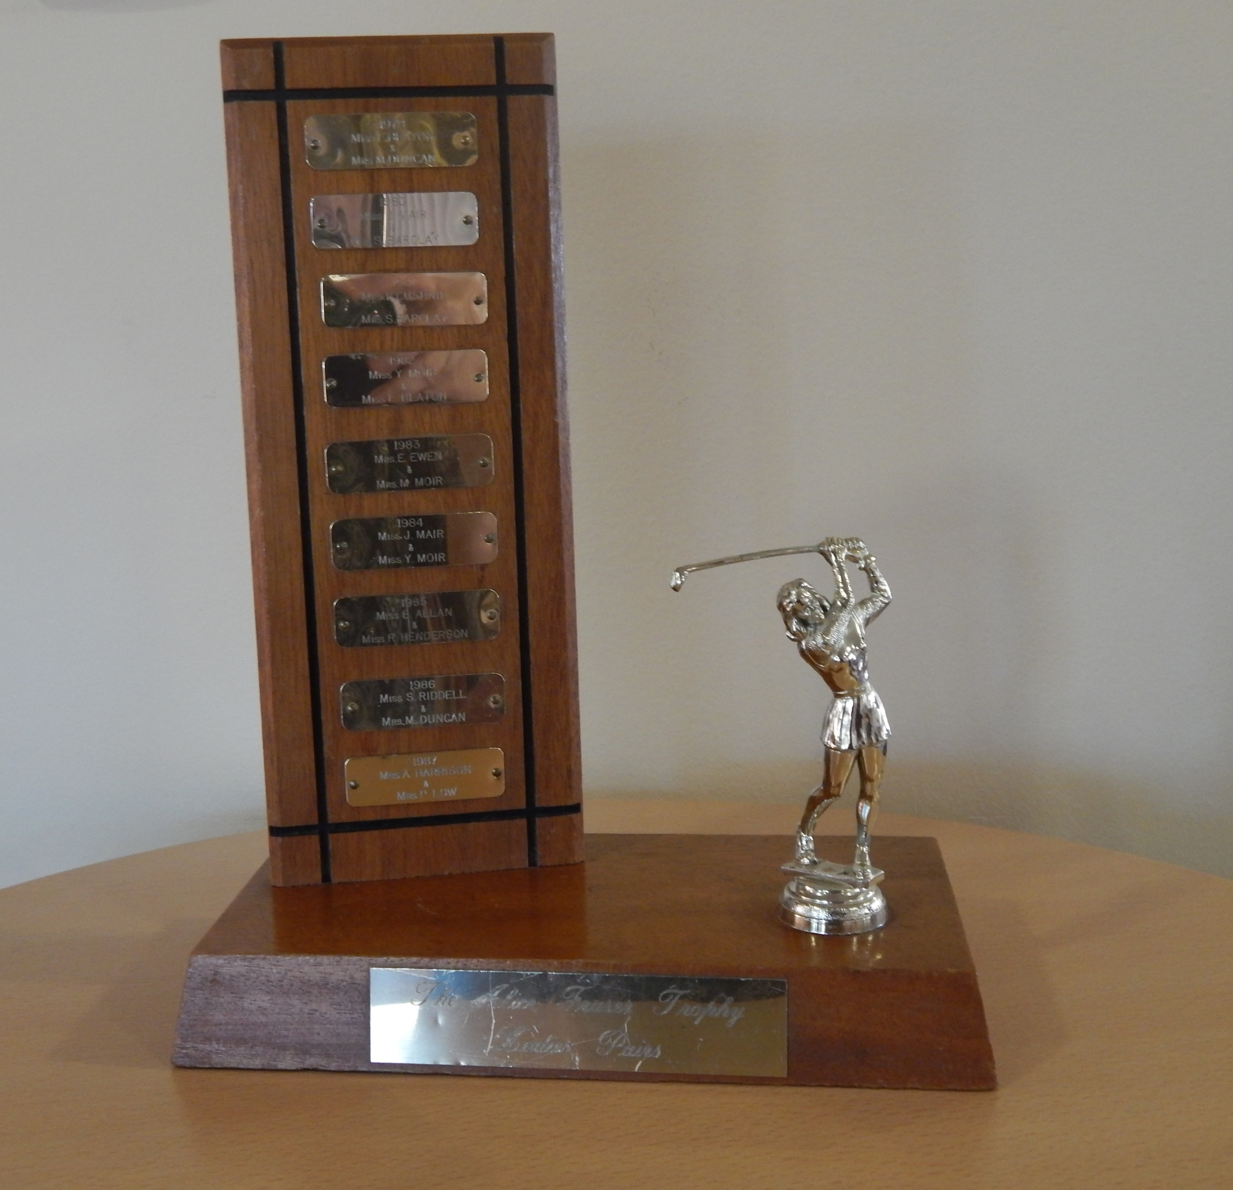
Wilma Catto and Jill Thomson won the Alice Fraser Pairs Trophy

Slide 33
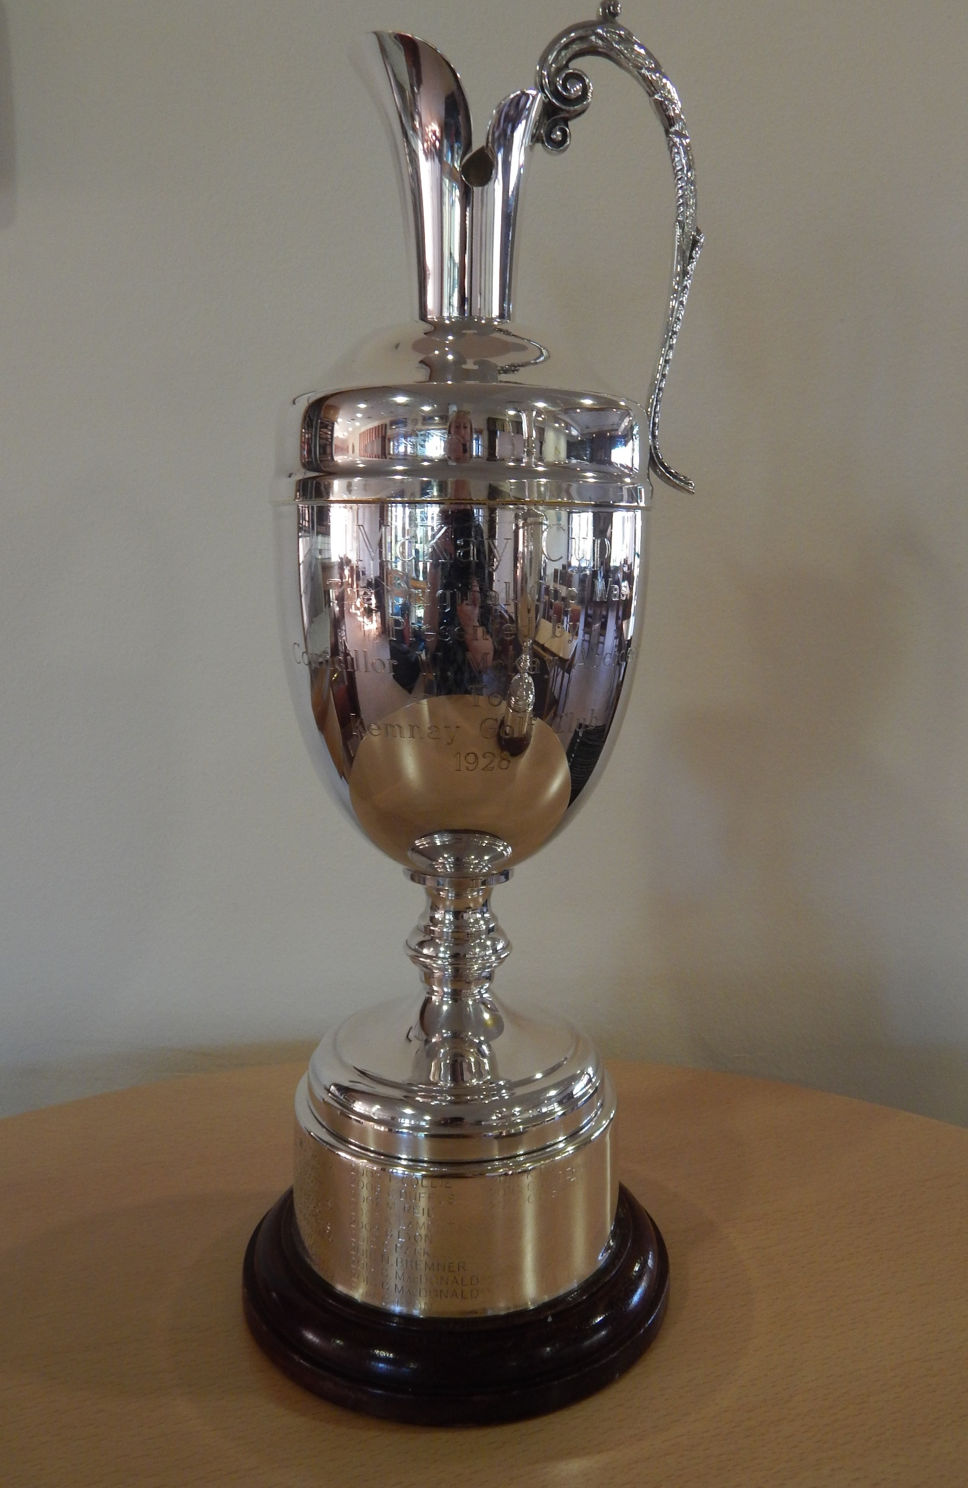
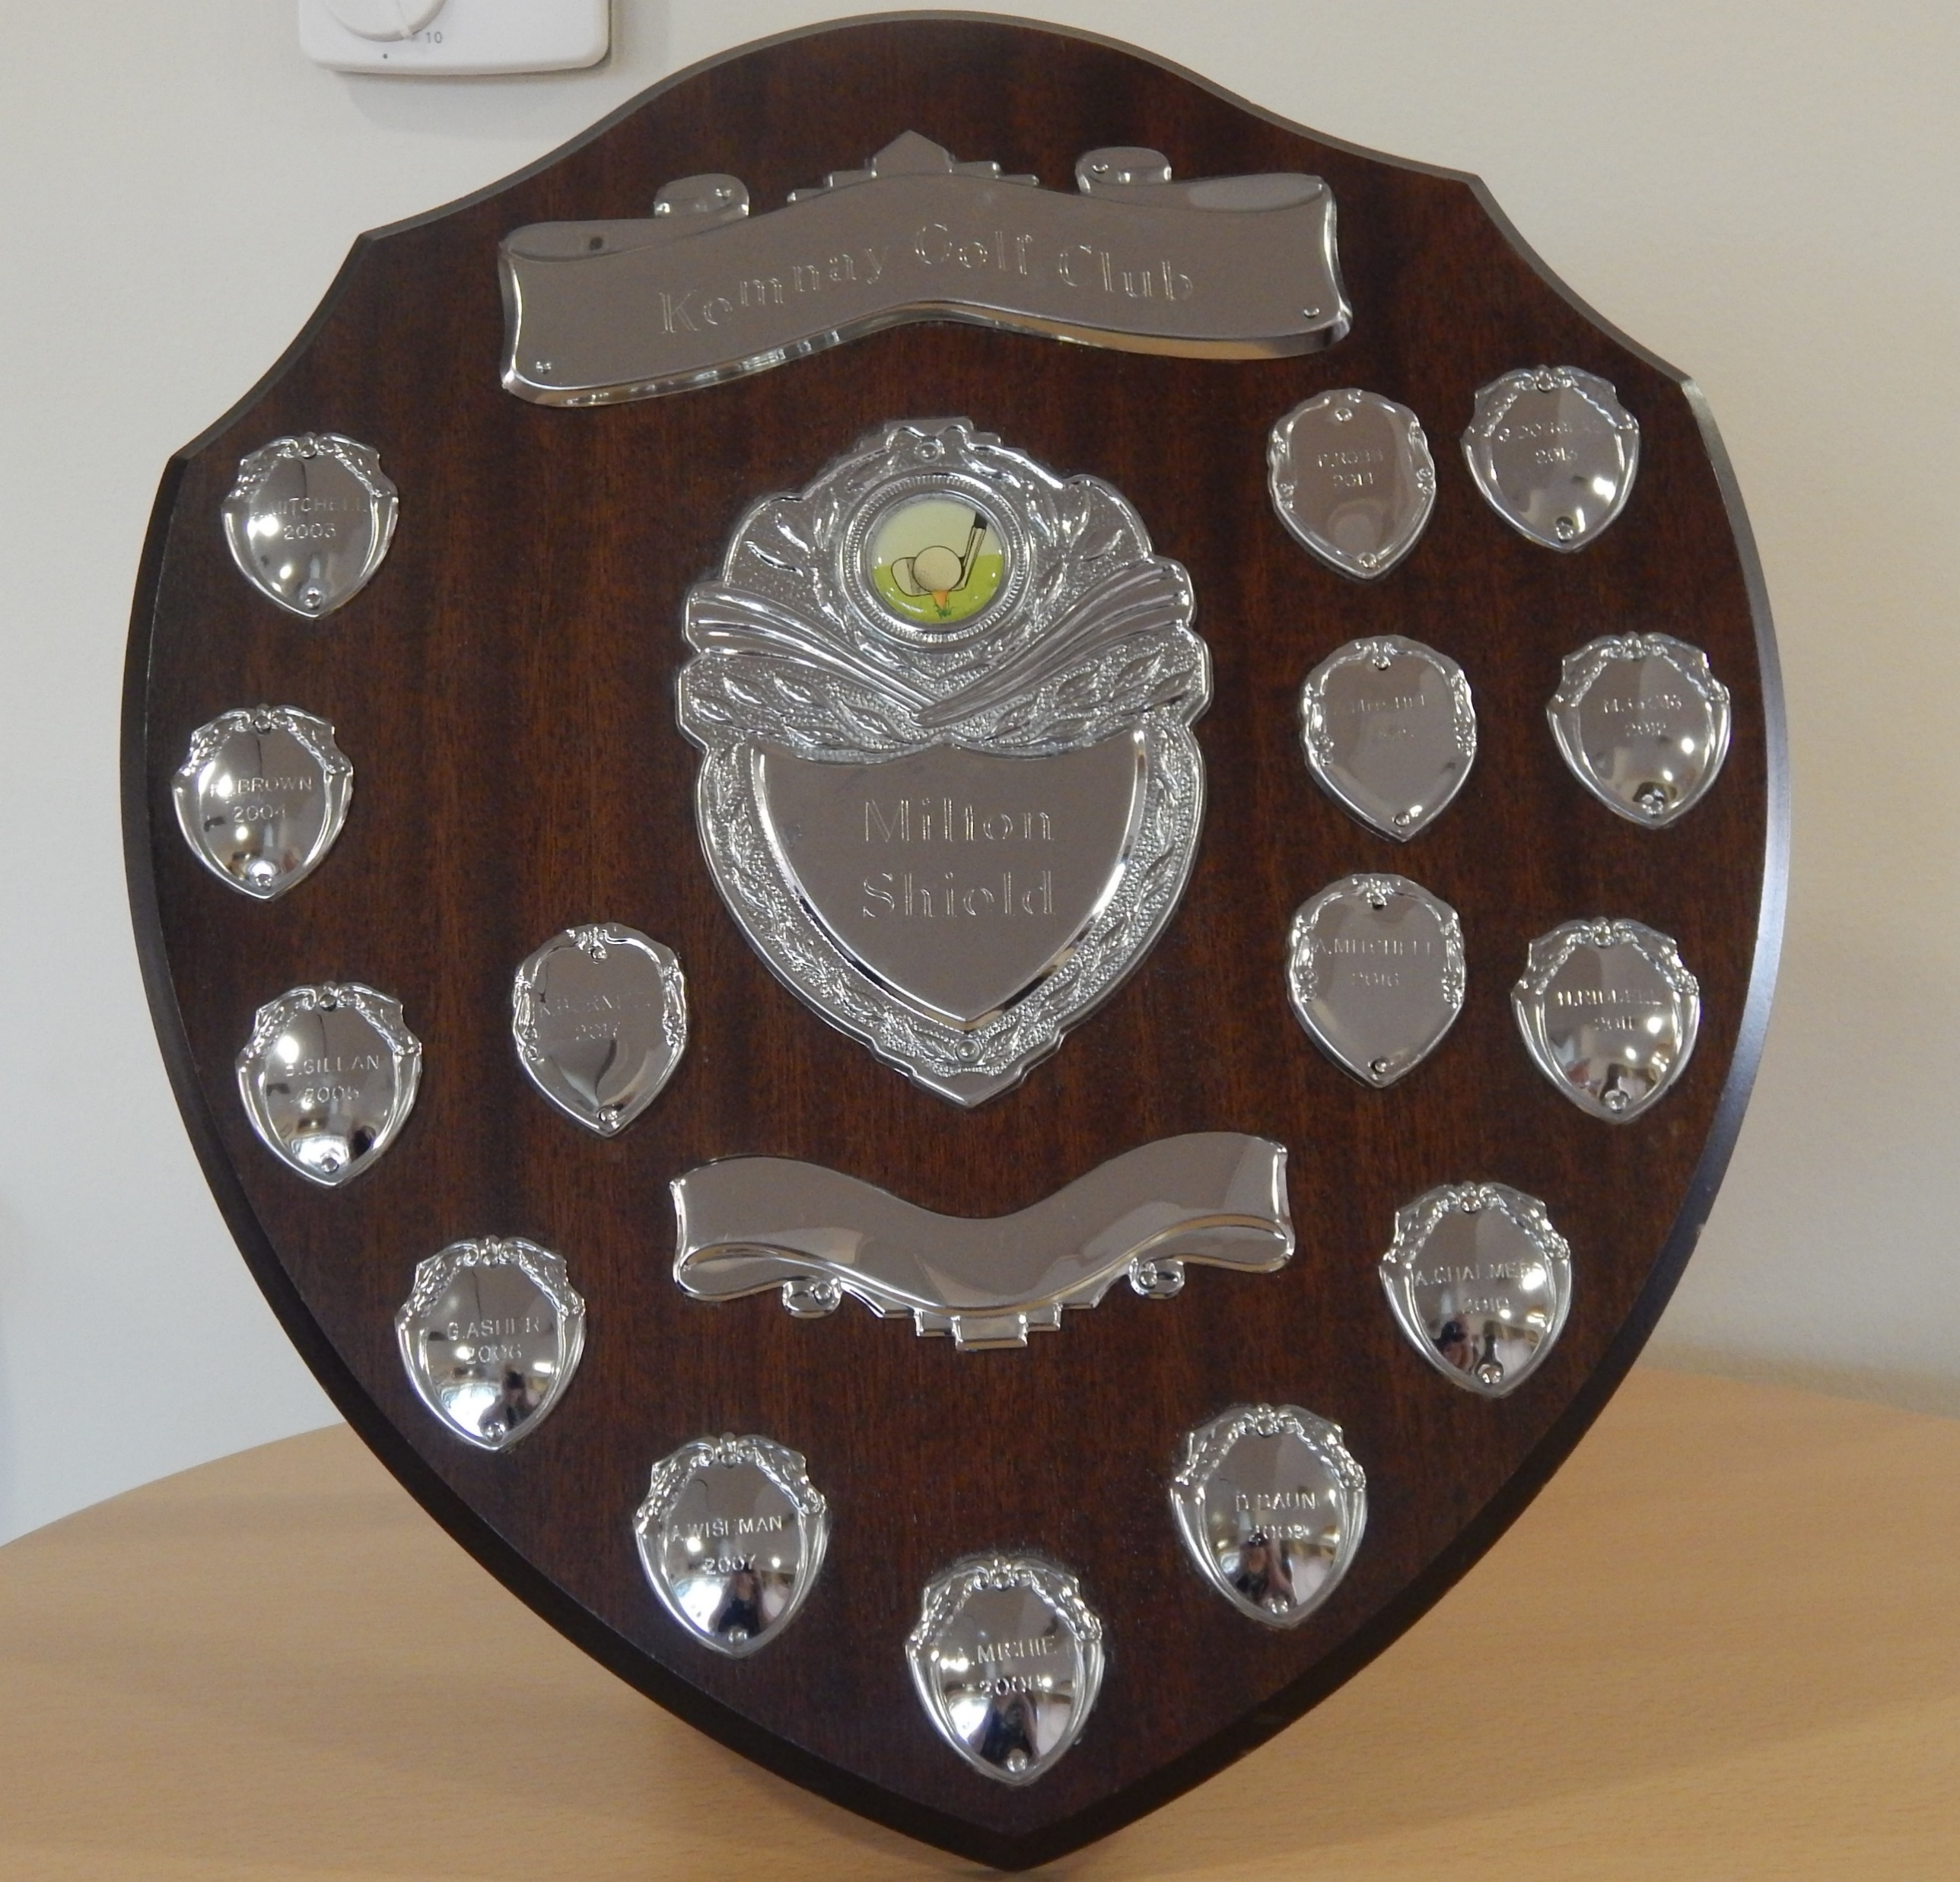
New member Paul Stewart won the MacKay Cup and the Milton Shield

Slide 34
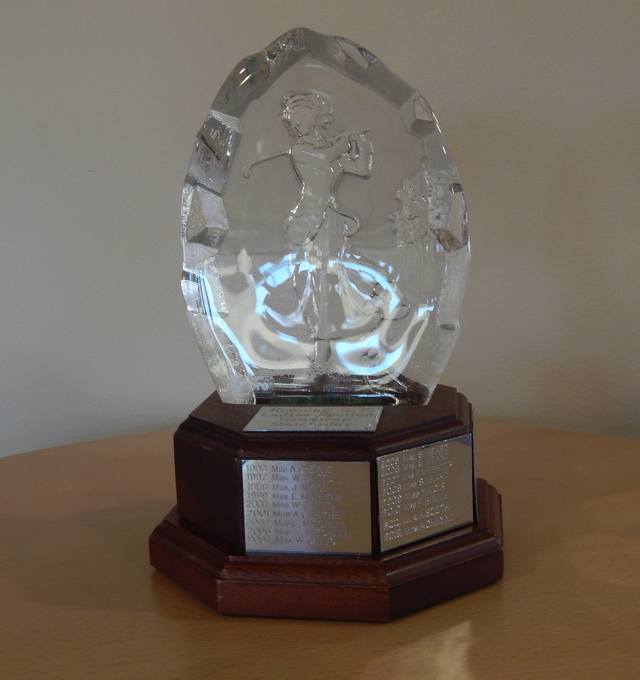
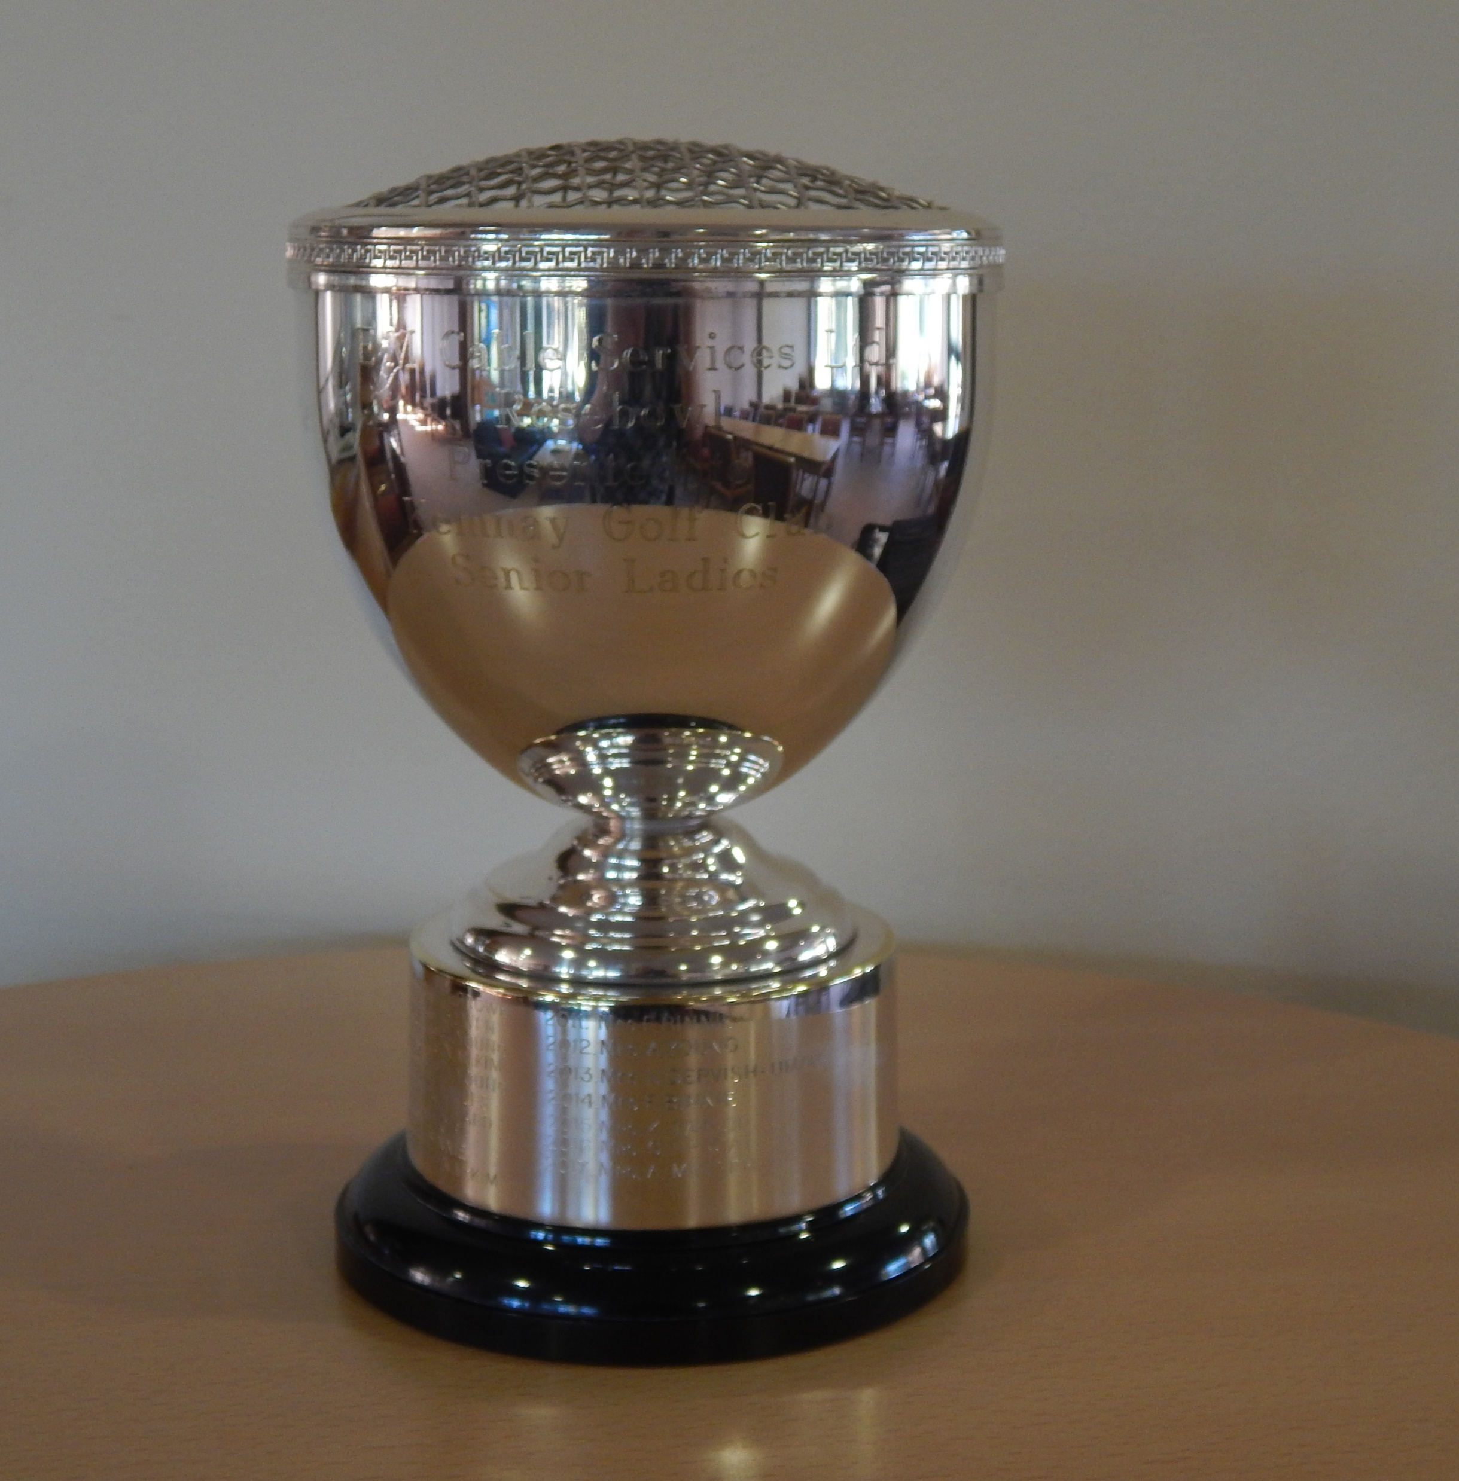
Wilma Catto won the Ladies Handicap Matchplay Trophy. Wilma also won the Senior Ladies Rosebowl.

Slide 35
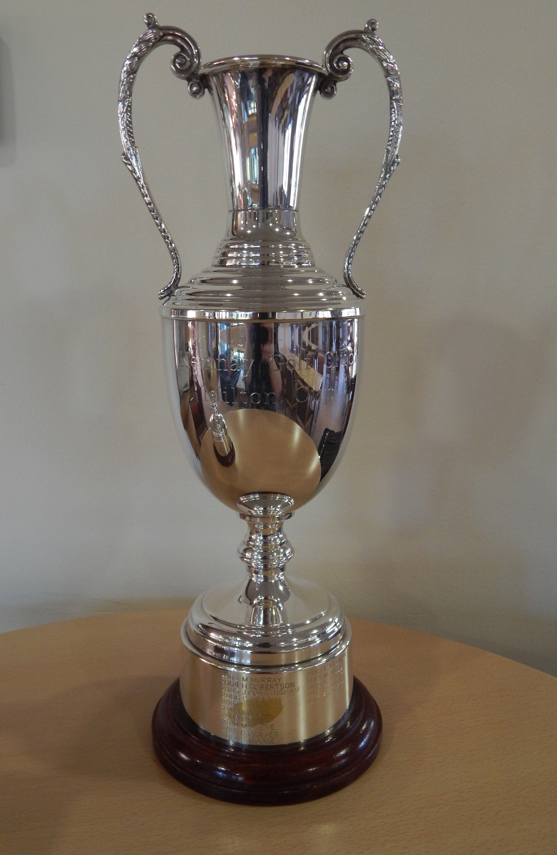
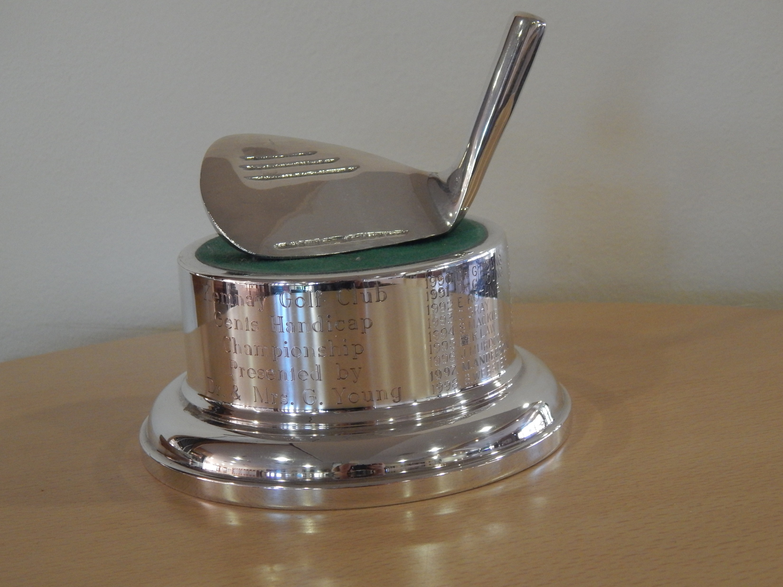
New member Tom Spiers won the Milton Cup and the Handicap Matchplay Trophy

Slide 36
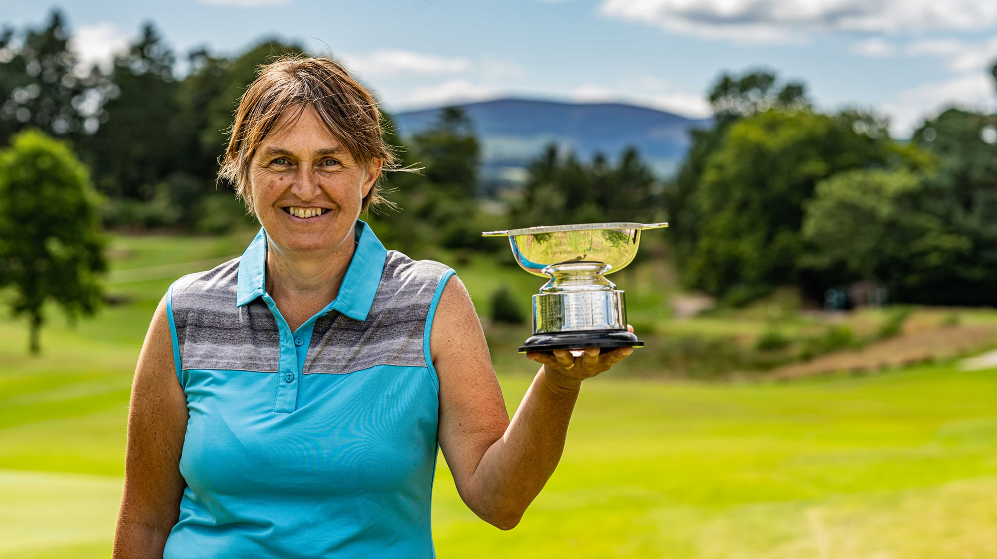
Anne Cheyne won the Ladies Handicap Championship and the Kate Taylor (Senior Ladies Matchplay) Trophy (add in)

Slide 37
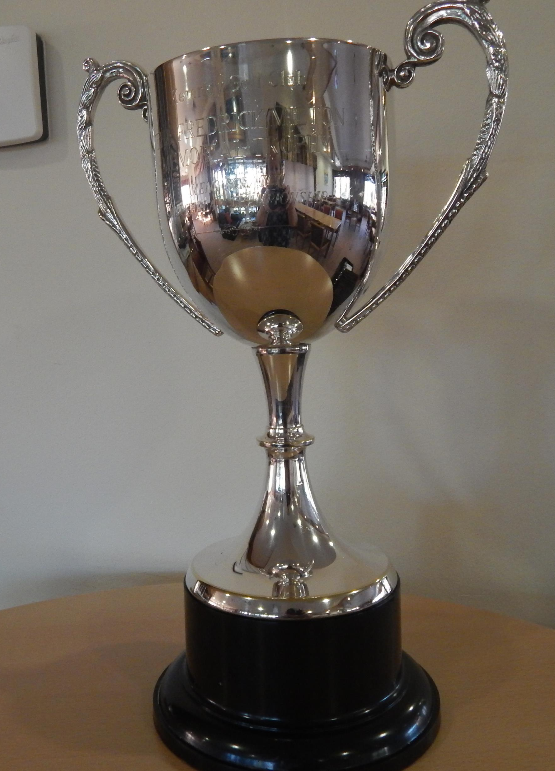
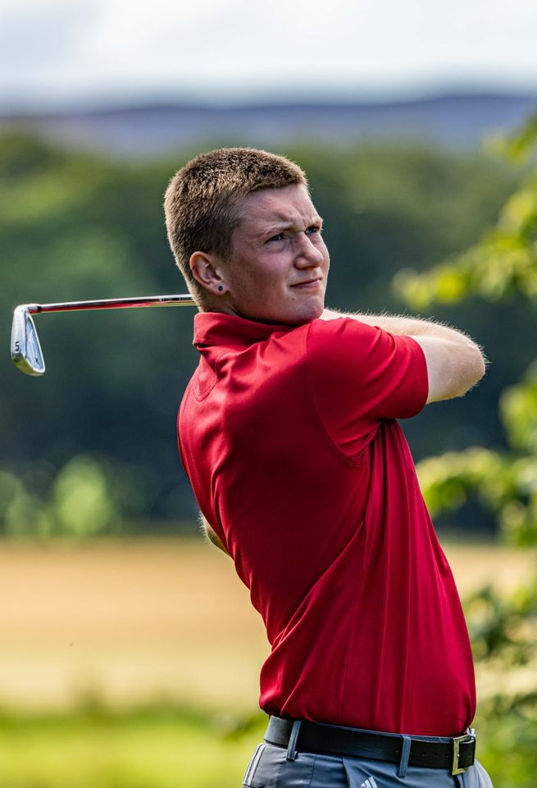
Kiran Nolan won the Scratch Matchplay Trophy for the 4th time and the 3rd year in a row!

Slide 38
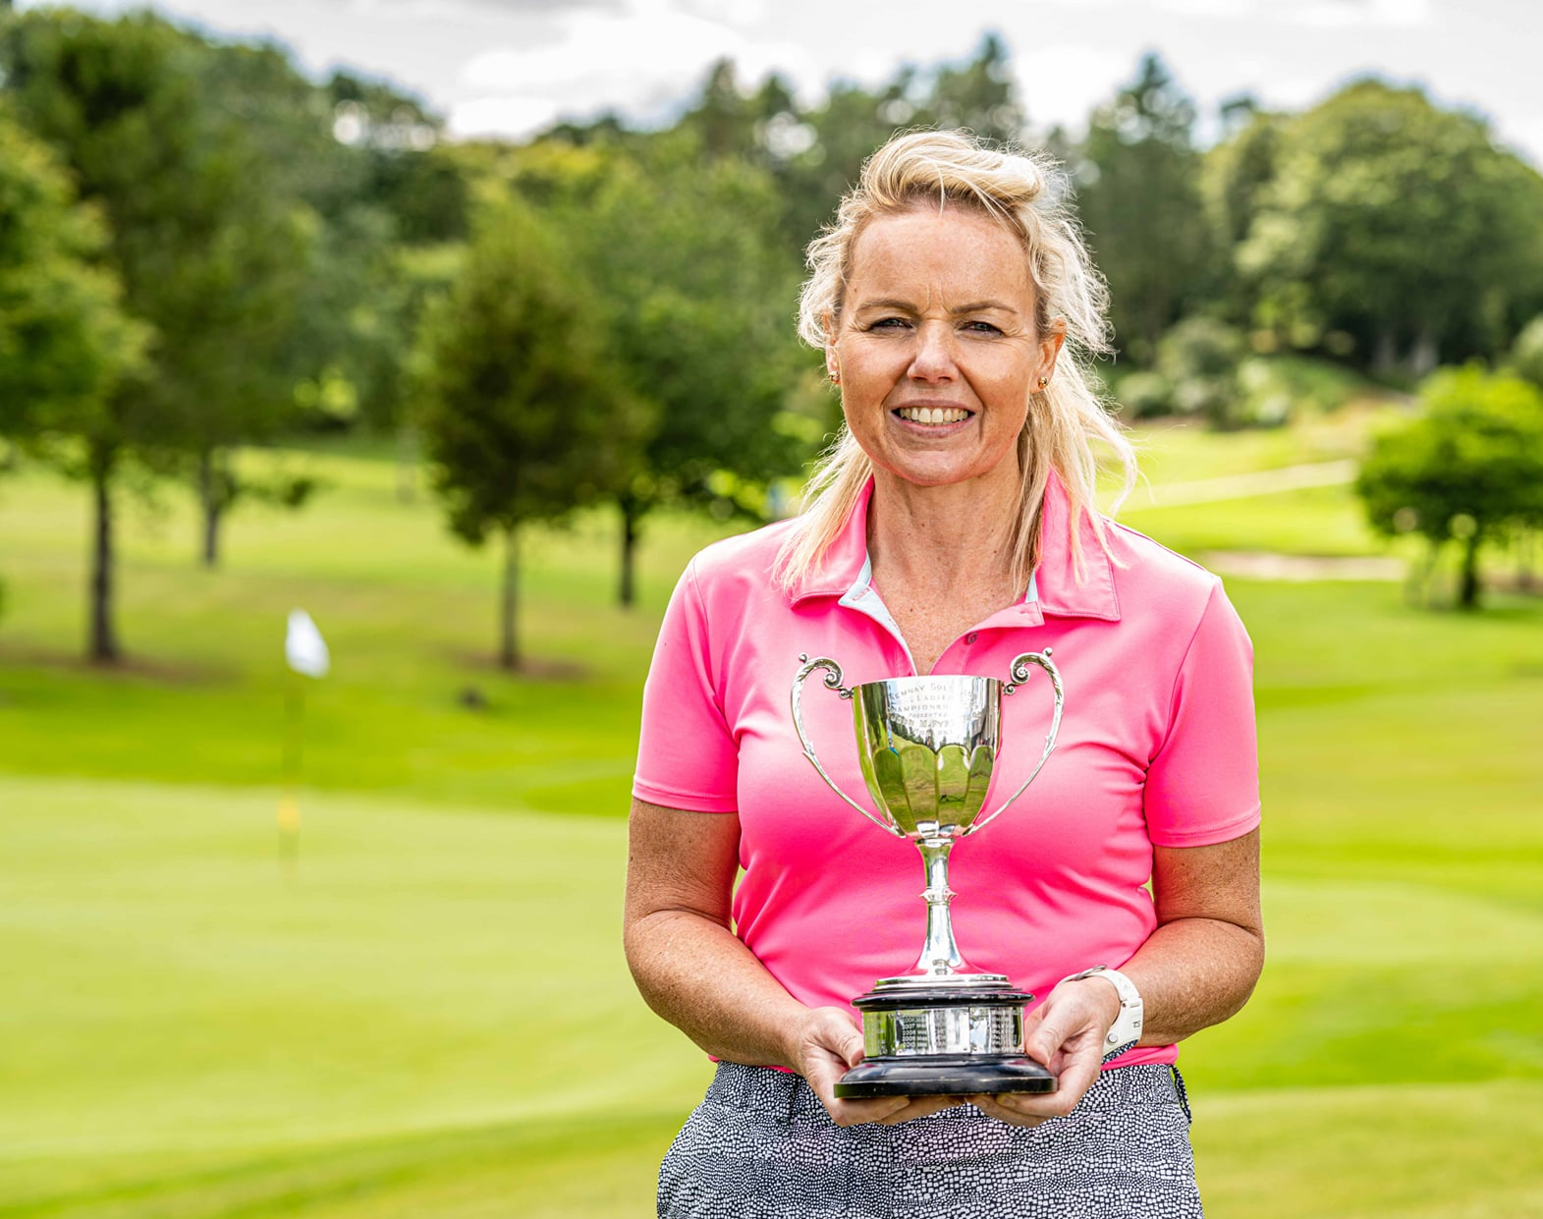
It was a 4th Championship Title for Fiona Pennie. Fiona also won the Ladies Order of Merit Trophy (add in)

Slide 39
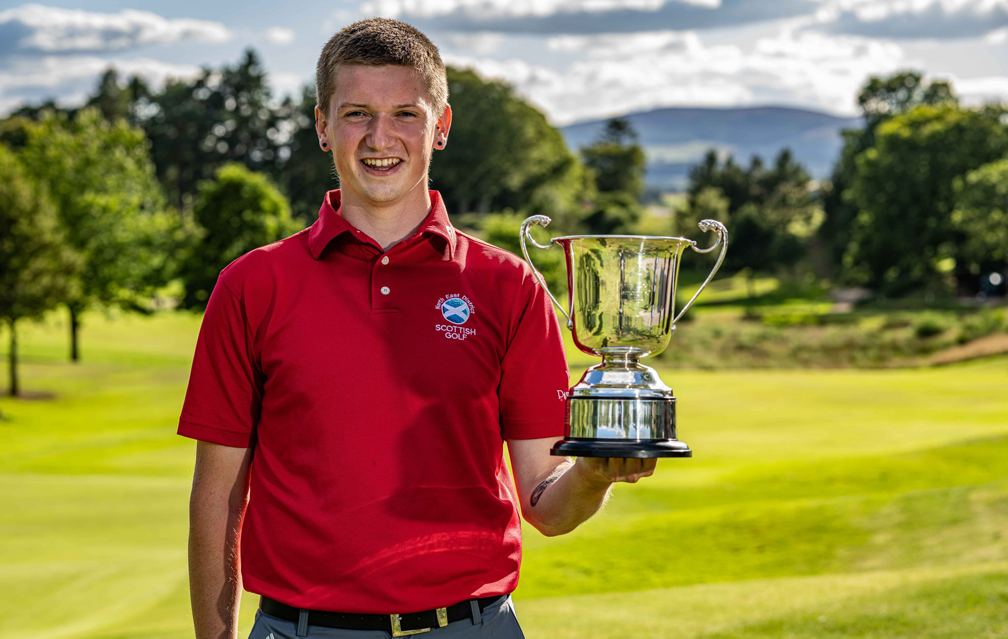
Kiran Nolan won the Gents Scratch Championship for the first time!

Slide 40
Our Club Champions, 2020

Slide 41
Special memories for all our winners…..

Slide 42
Conclusions
Yvonne voice over or video clip?
Slides
Merry Christmas from the Greenkeeping team (& bothy)
Merry Christmas from the Pro Shop
Merry Christmas from Admin
Final message to stay safe….enjoy time with families….look forward to 2021!

